Slide 1
AN ANALYSIS OF HUNTER STREET, NEWCASTLE
STREET ART OR GRAFFITI?
WEI PINK CHIA 3289329

Slide 2
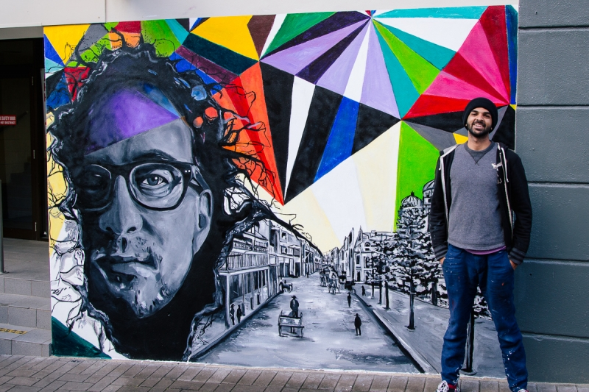
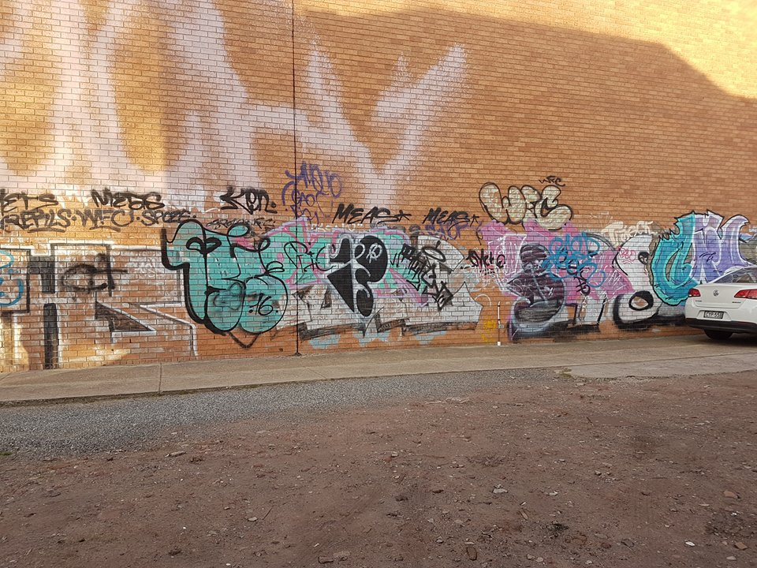
STREET ART OR GRAFFITI
STREET ART IS MORE ABOUT INTERACTING WITH THE AUDIENCE ON THE STREET AND THE PEOPLE, THE MASSES. STREET ART IS MUCH MORE OPEN. AN OPEN SOCIETY. ^{[ 6 ]}
GRAFFITI ISN’T SO MUCH ABOUT CONNECTING WITH THE MASSES; IT’S ABOUT CONNECTING WITH DIFFERENT CREW, IT’S AN INTERNATIONAL LANGUAGE. IT’S A SECRET LANGUAGE. MOST GRAFFITI YOU CAN’T EVEN READ. ^{[ 6 ]}
PICTURE 1 ^{[ 7 ]}
PICTURE 2

Slide 3
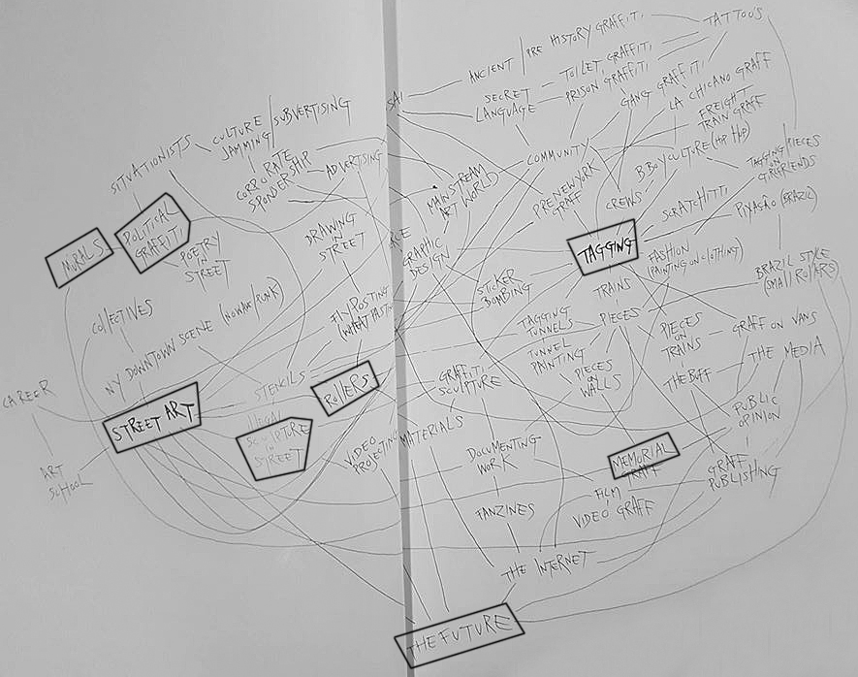
MAPPING DIAGRAM
BY CEDAR LEWISOHN
DIFFERENT TYPES OF STREET ART ARE MAPPED :
THIS INCLUDES:
MURALS,
POLITICAL GRAFFITI,
SCULPTURE,
TAGGIGING,
MEMORIAL MURAL & MORE…
STREET ART, THE GRAFFITI REVOLUTION
PICTURE: ^{[ 6 ]}

Slide 4
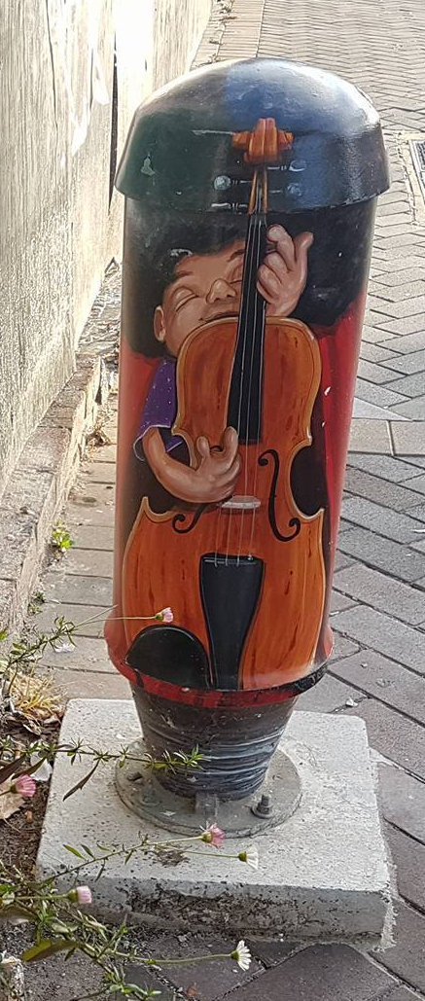
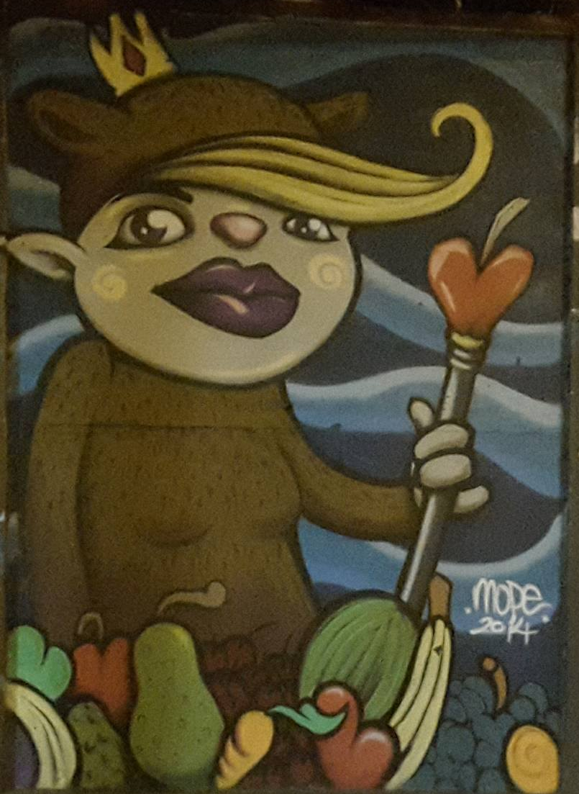
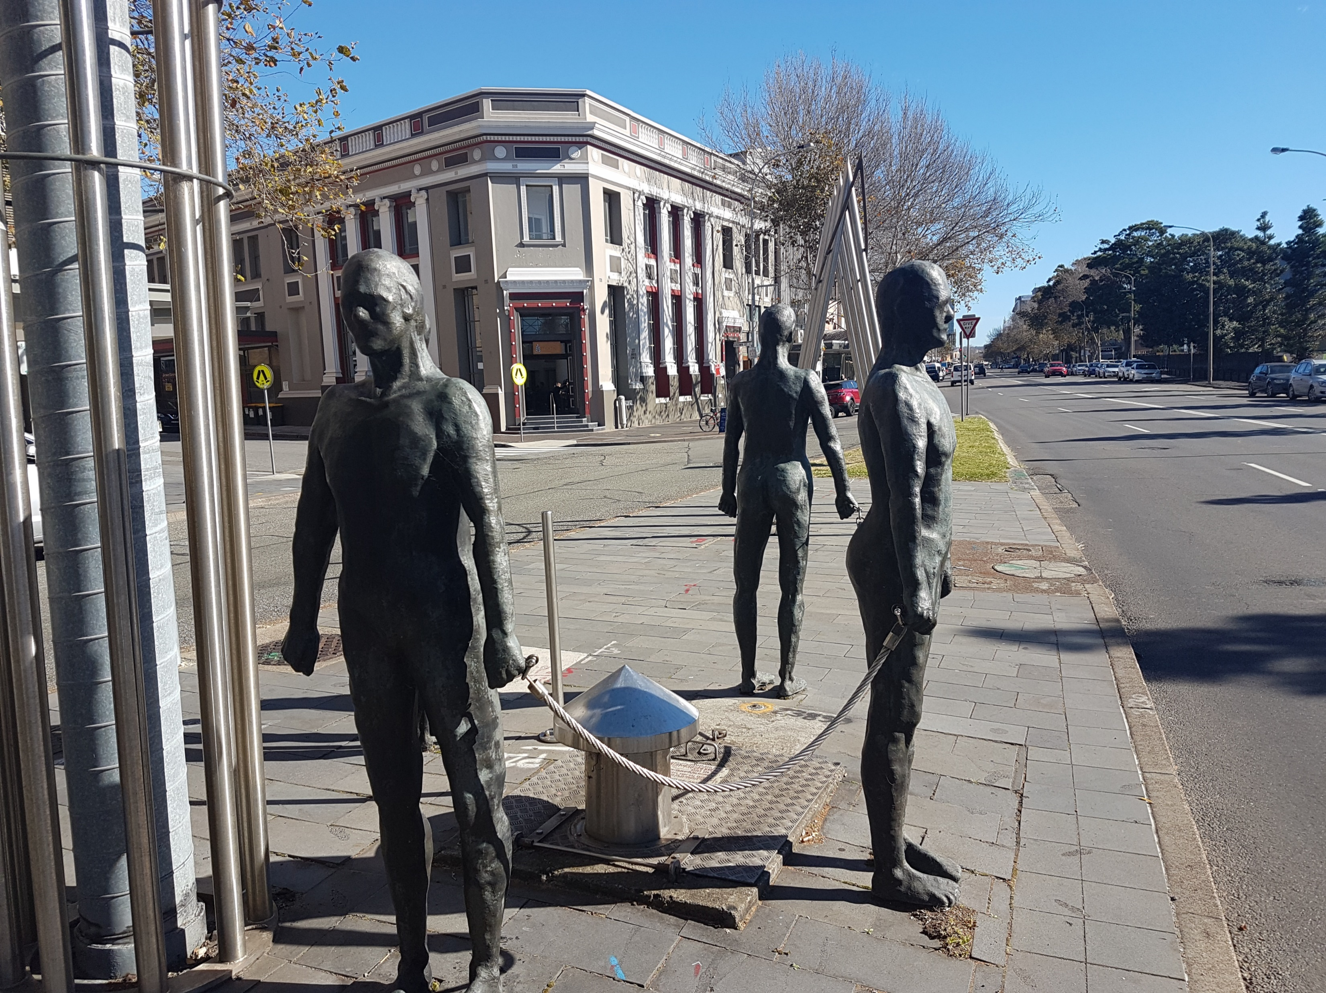
TERMS OFTEN USED IN STREET ART
TAGGING
CHARACTER MURAL
MURAL ^{[ 7 ]}
INVADER / SCULPTURE
A stylized name or signature done with various materials, such as a marker or an aerosol spray can, often freehand. Depending on its format or complexity, a tag may be called a throw-up, as in “that throw-up is amazingly detailed,” not as in “this Sharpie scrawl makes me want to throw up my cookies.” A person who tags is known as a writer or bomber. ^{[ 8 ]}
Cute or creepy, cartoonish or realistic, a character serves as a signature or visual shorthand. If you know the character, you know the artist. Some artists take their characters from comic books or television, but many invent wholly original beings. A character can be put up on its own or as part of a larger narrative scene. ^{[ 8 ]}
A huge work, often on a legal wall. It might be done by an individual, an informal group, or a crew. A mural might depict a single scene, or it might be a series of standalone or loosely connected images or characters. ^{[ 8 ]}
A site-specific work, often 3D or sculptural. Temporary or permanent, an installation may combine several techniques. ^{[ 8 ]}

Slide 5
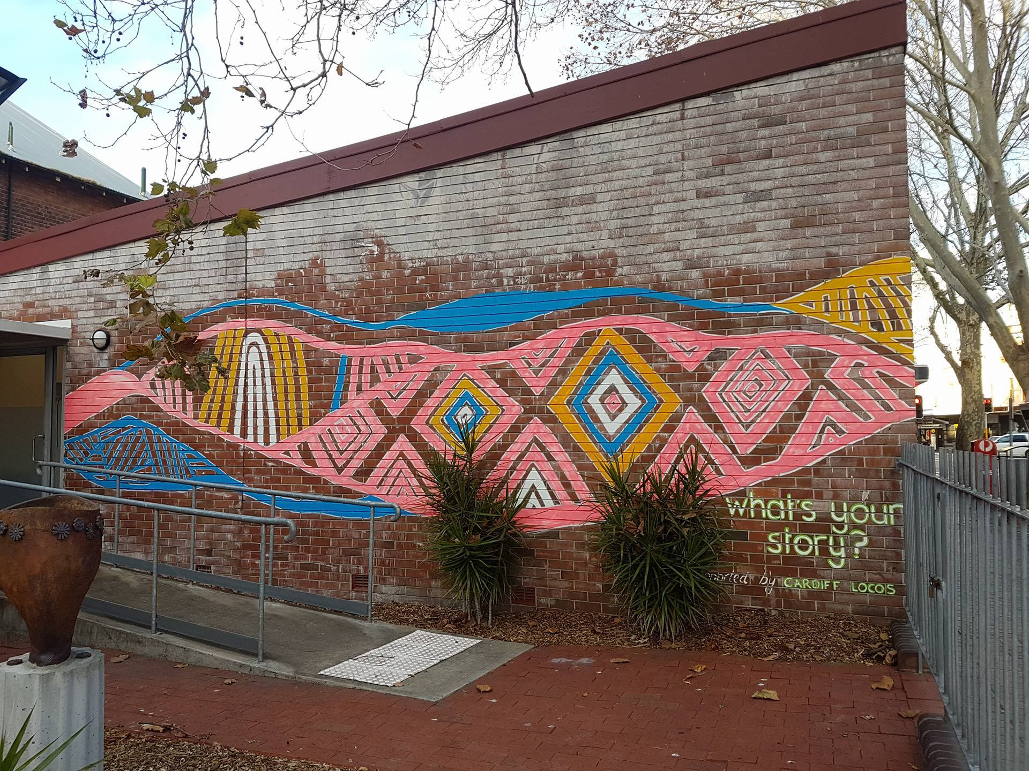
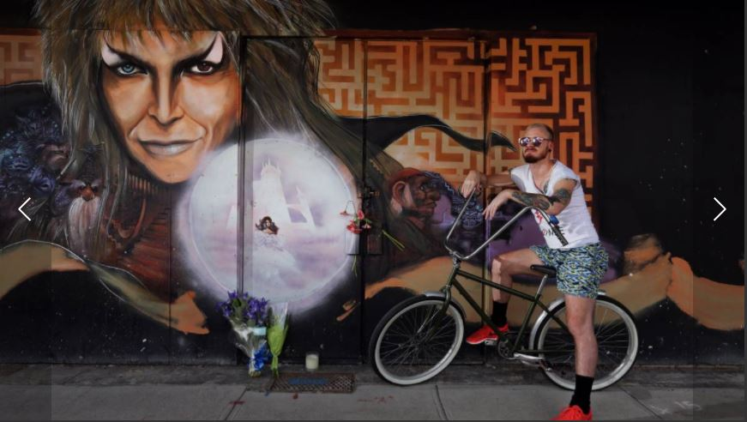
TYPES OF STREET ART IN HUNTER STREET
TAGGING
NARRATIVE MURAL
CHARACTER MURAL
PORTRAIT MURAL ^{[ 7 ]}
HERITAGE SCULPTURE
MEMORIAL MURAL ^{[ 2 ]}

Slide 6
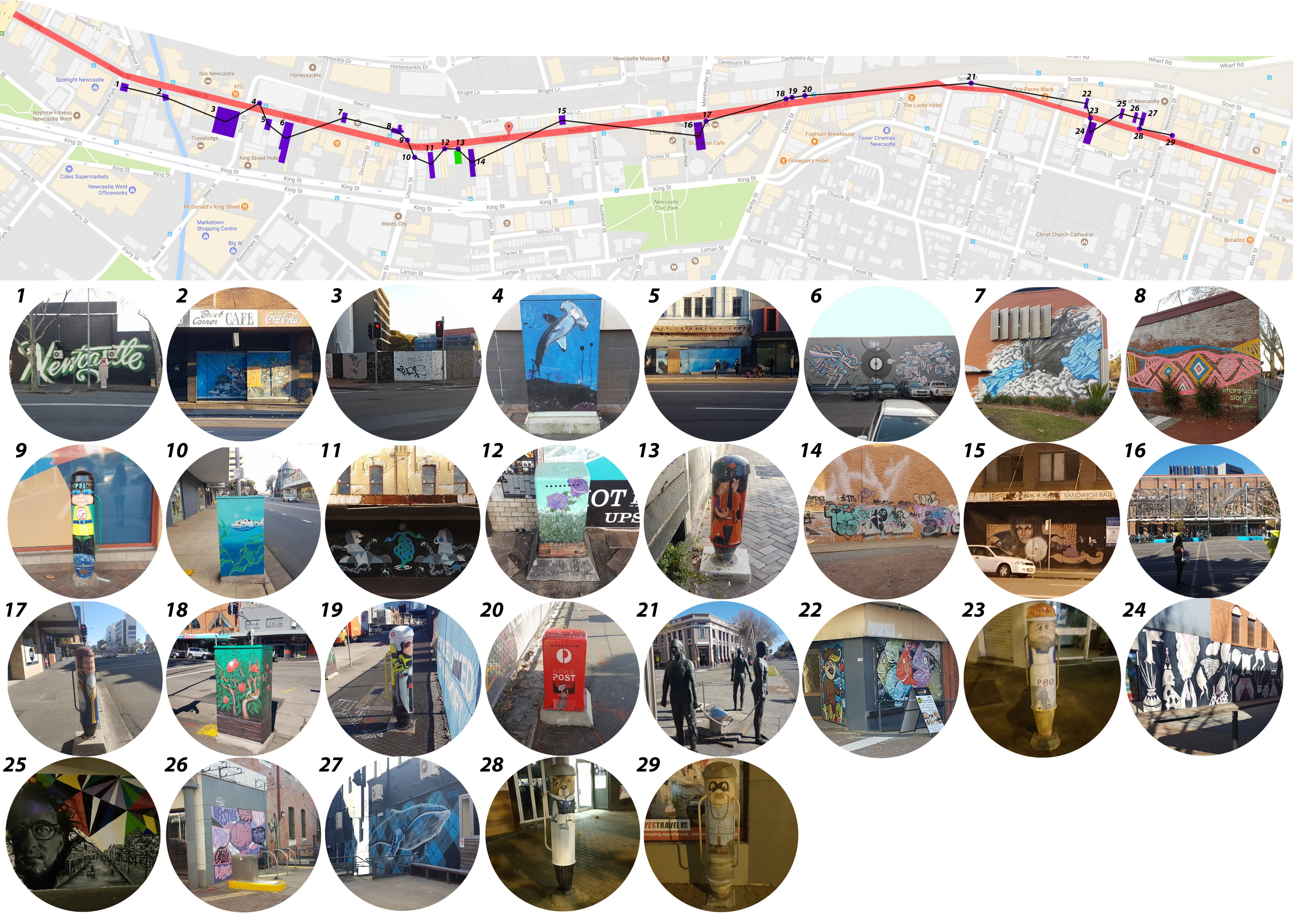
LOCATION OF STREET ART IN HUNTER STREET

Slide 7

LOCATION OF STREET ART IN HUNTER STREET
DIAGRAM 1.1: SHOWING AREA OF STREET ART IN HUNTER ST

Slide 8
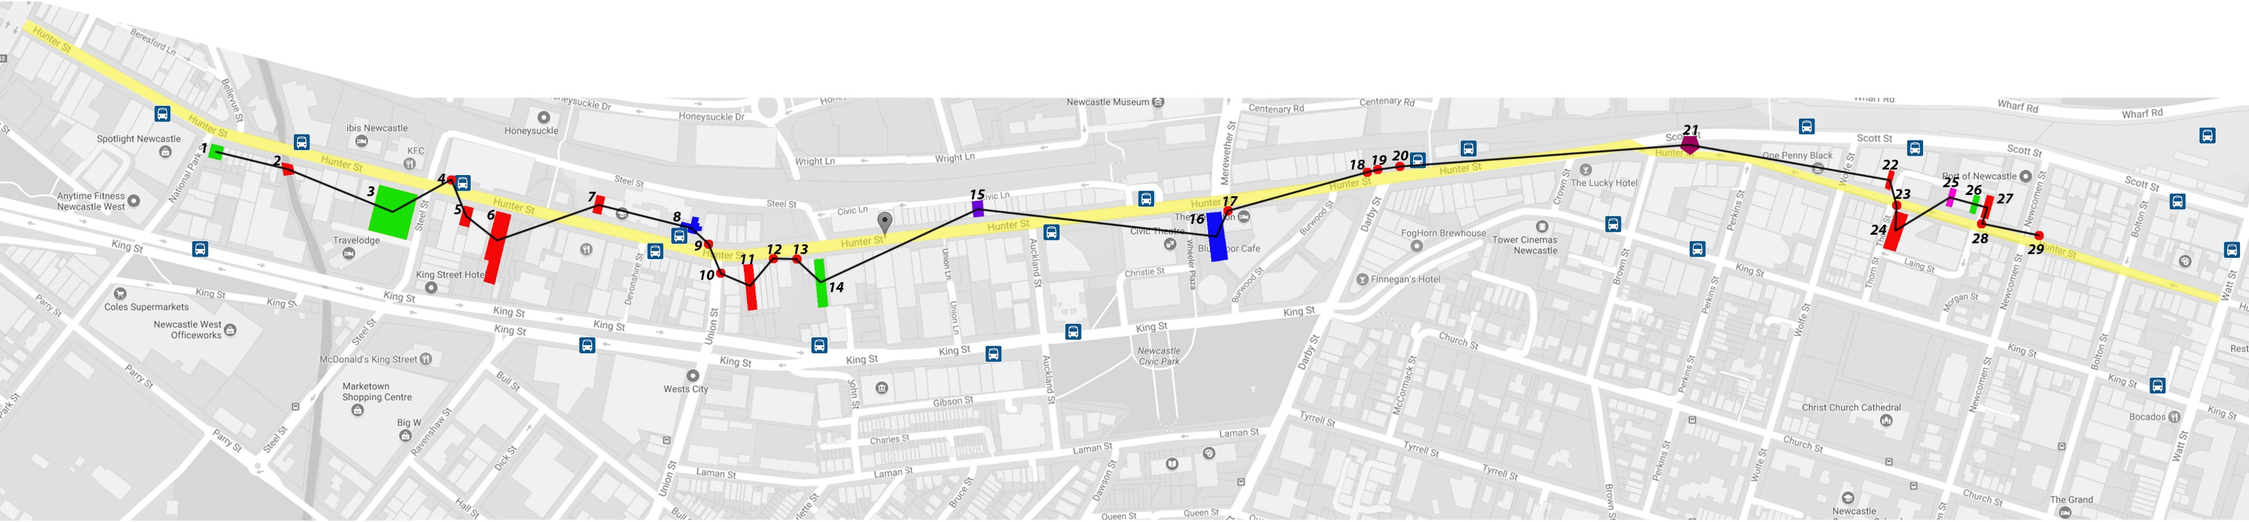
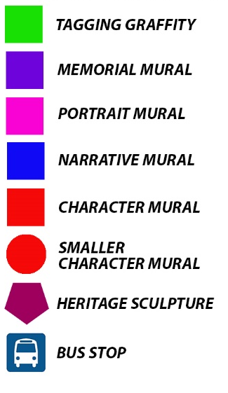
TYPES OF STREET ART IN HUNTER STREET
DIAGRAM 1.2: SHOWING DIFFERENT TYPES OF STREET ART IN HUNTER ST
4
1
1
2
8
12
1

Slide 9
TYPES OF STREET ART IN HUNTER STREET
DIAGRAM 1.3: SHOWING DIFFERENT TYPES OF STREET ART IN HUNTER ST
13.79%
3.45%
3.45%
6.90%
27.59%
68.97%
41.38%
3.45%

Slide 10
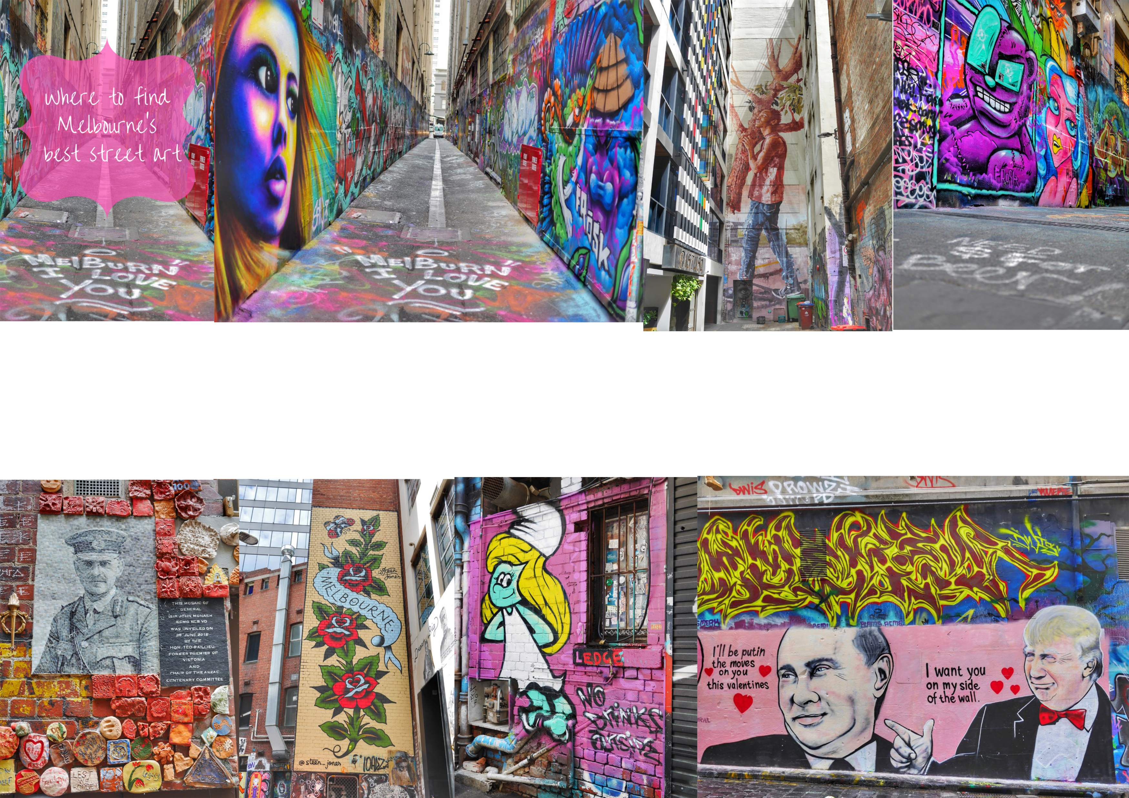
SOME GOOD EXAMPLE OF STREET ART IN MELBOURNE
PICTURE : SHOWING THE STREET ART IN DIFFERENT AREA IN MELBOURNE, AUSTRALIA ^{[ 3 ]}

Slide 11
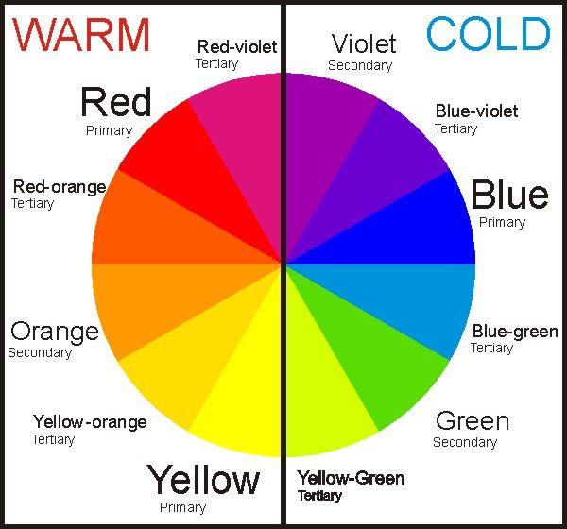
COLOR SYSTEM
STREET ART IN HUNTER STREET –DOES COLOR AFFECT AUDIENCE’S ATTENTION?
FaberBirren explains his COLOUR-CIRCLES in accordance with the practicalities of art and artists. He differentiates between «warm» and «cold» colours, and recommends a «Rational Color Circle» which groups 13 colours around a grey which is displaced from the centre. He thus presents a system which assigns more space to the «warm» colours between red and yellow than the «cold» colours occurring between green and violet. As a result, Birren takes account of the eye’s ability to distinguish more warm colours, which are therefore granted greater importance in art. ^{[ 4 ]}
DIAGRAM : SHOWING THE SCALE OF WARM & COOL COLOR ^{[ 4 ]}

Slide 12
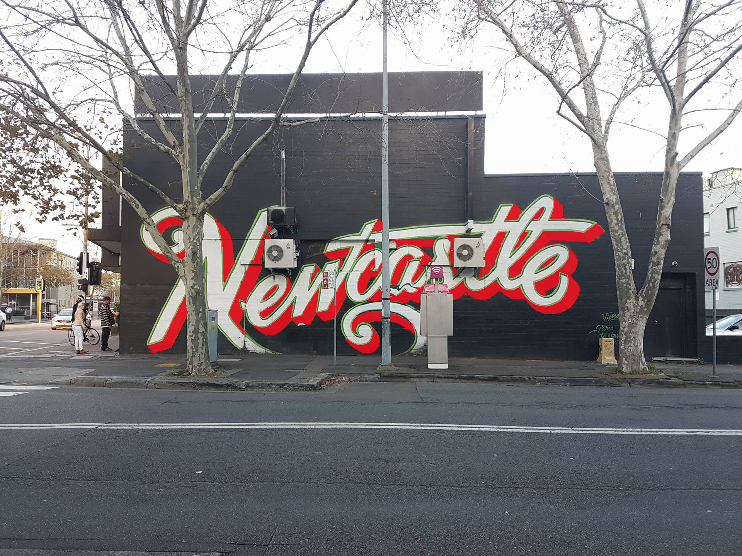
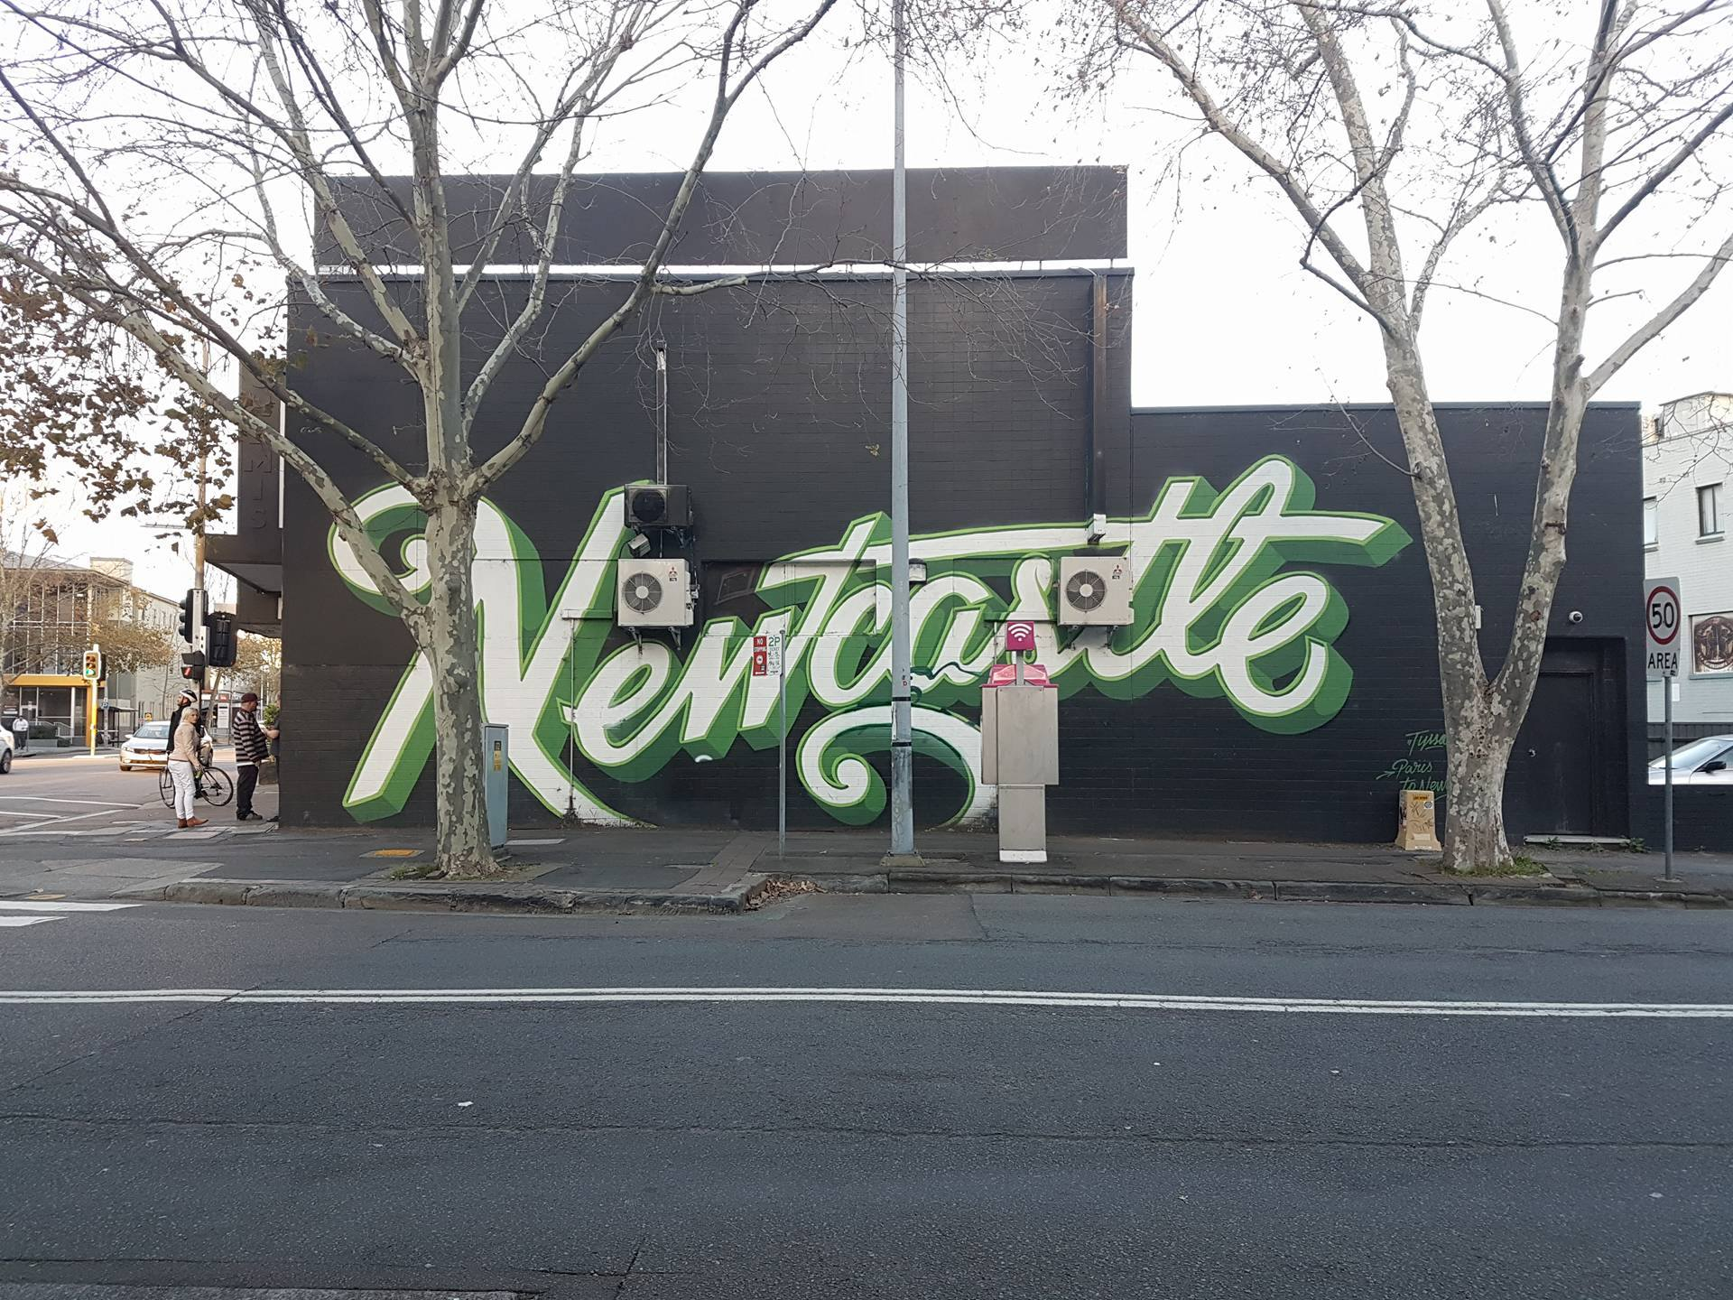
STREET ART IN HUNTER STREET –DOES COLOR AFFECT AUDIENCE’S ATTENTION?
WARMER COLOR
COOLER COLOR
PICTURE 1
PICTURE 2

Slide 13
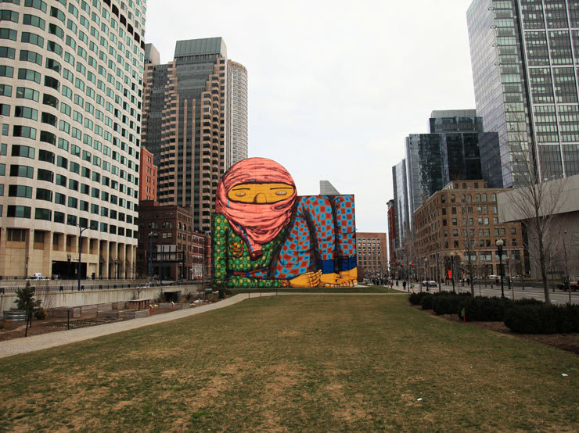
THE POWER OF COLOR VIA STREET ART, GRAFFITI AND MURALS
Faber Birren developed his color system with the observation that artists favor the warm colors more than the cold, from the violet side of red and extending beyond yellow because “, their effect is more dynamic and intense and because the eye can, in fact, distinguish more warm colors than cold.” ^{[ 5 ]}
“Color is something that architects are usually afraid of,” said internationally known and awarded architect Benedetta Tagliabue in an interview last May about the topic of color. ^{[ 5 ]}
A generalization probably, and you can always find exceptions of colorfully painted neighborhoods globally like the Haight in San Francisco, La Boca in Buenos Aires, Portafino in Italy, Guanajuato in Mexico, Bo-Kaap in Capetown, the favelas of Rio de Janeiro and the Blue City of India, but many of those examples speak to color blocking and pattern. ^{[ 5 ]}
PICTURE : FINANCIAL DISTRICT IN DOWNTOWN BOSTON, MASSACUSETTS ^{[ 5 ]}

Slide 14
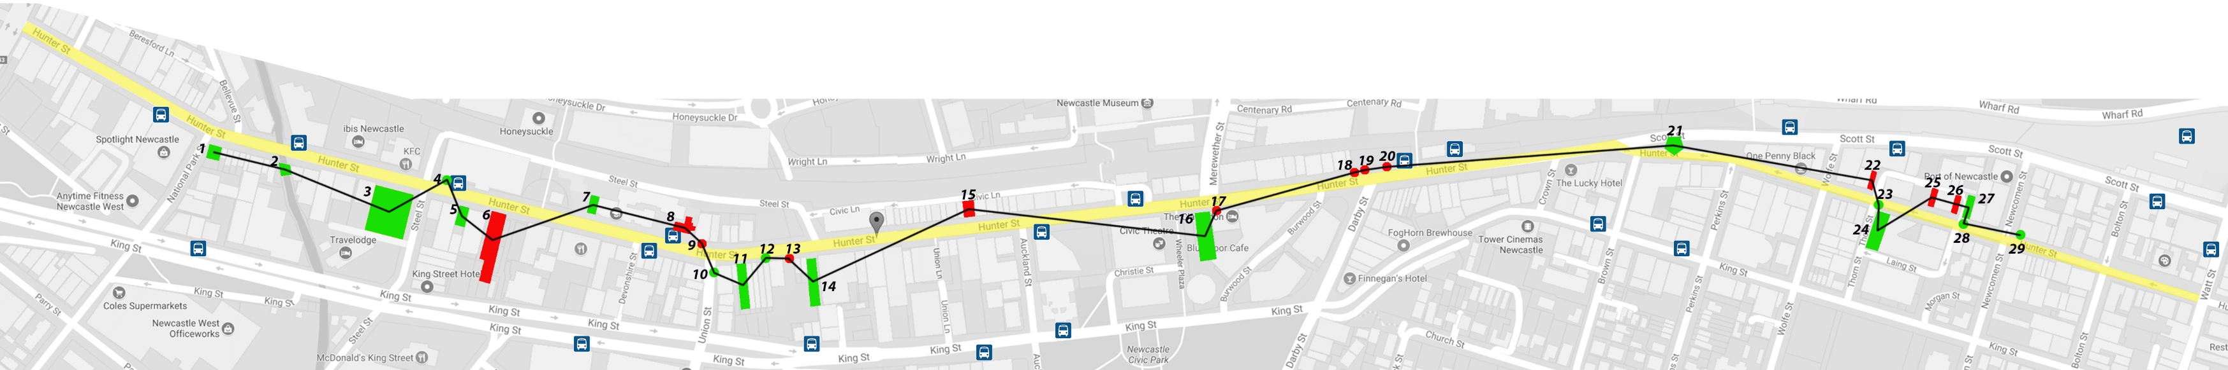

COLORS OF STREET ART IN HUNTER STREET
DIAGRAM 2.1: SHOWING WARM & COOL COLOR STREET ART IN HUNTER ST
58.62%
41.38%

Slide 15

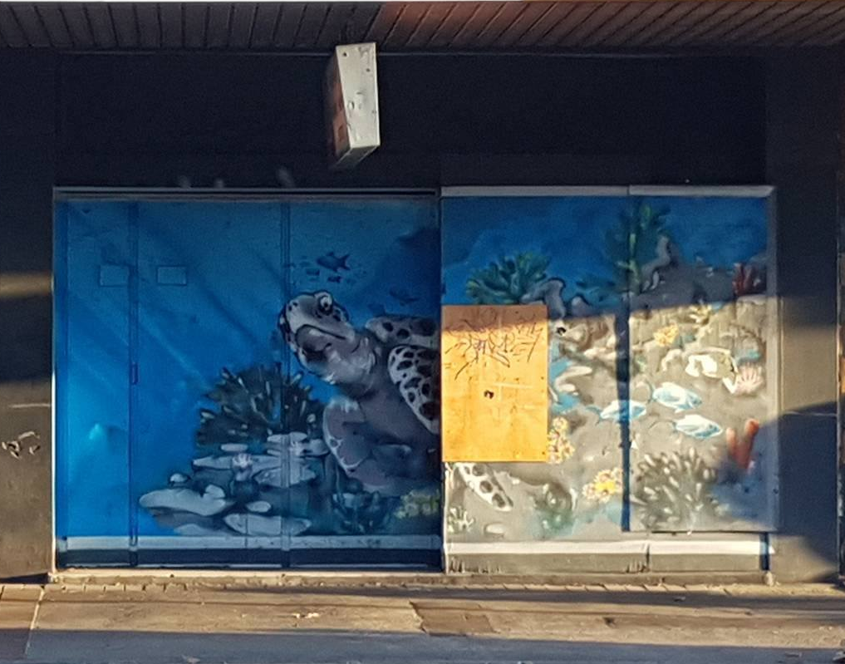
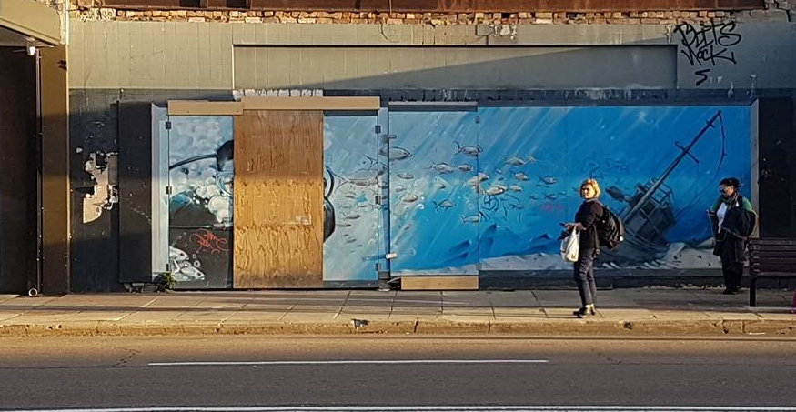
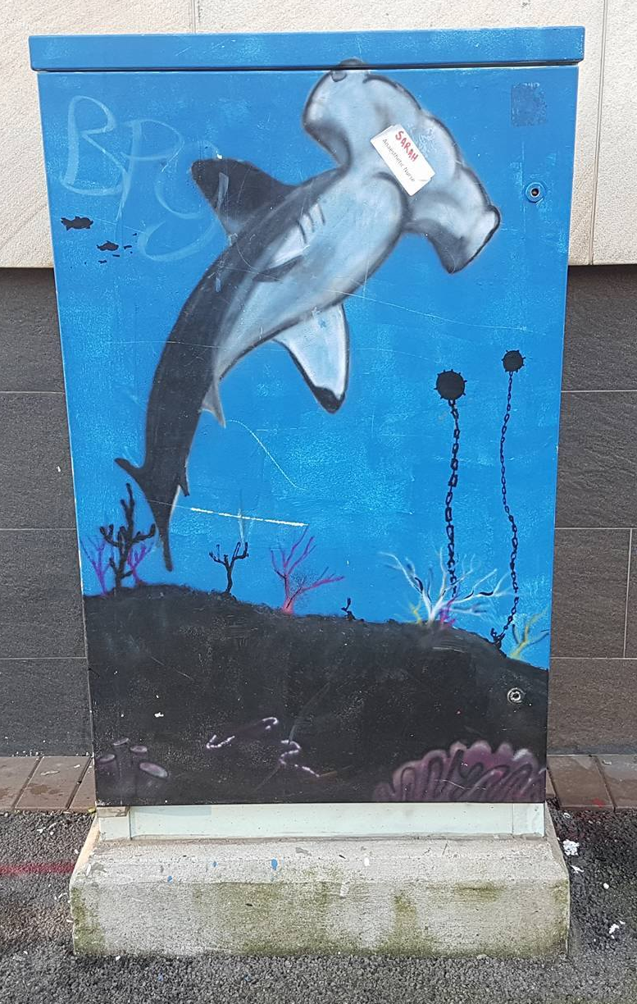
STREET ART WITH COOL COLORS TEND TO BE VANDALIZED & IGNORED
DIAGRAM 2.2: SHOWING AREA OF COOL COLOR STREET ART IN HUNTER ST
PICTURE 1: LOCATE IN NO. 2
PICTURE 2: LOCATE IN NO. 4
PICTURE 3: LOCATE IN NO.5

Slide 16
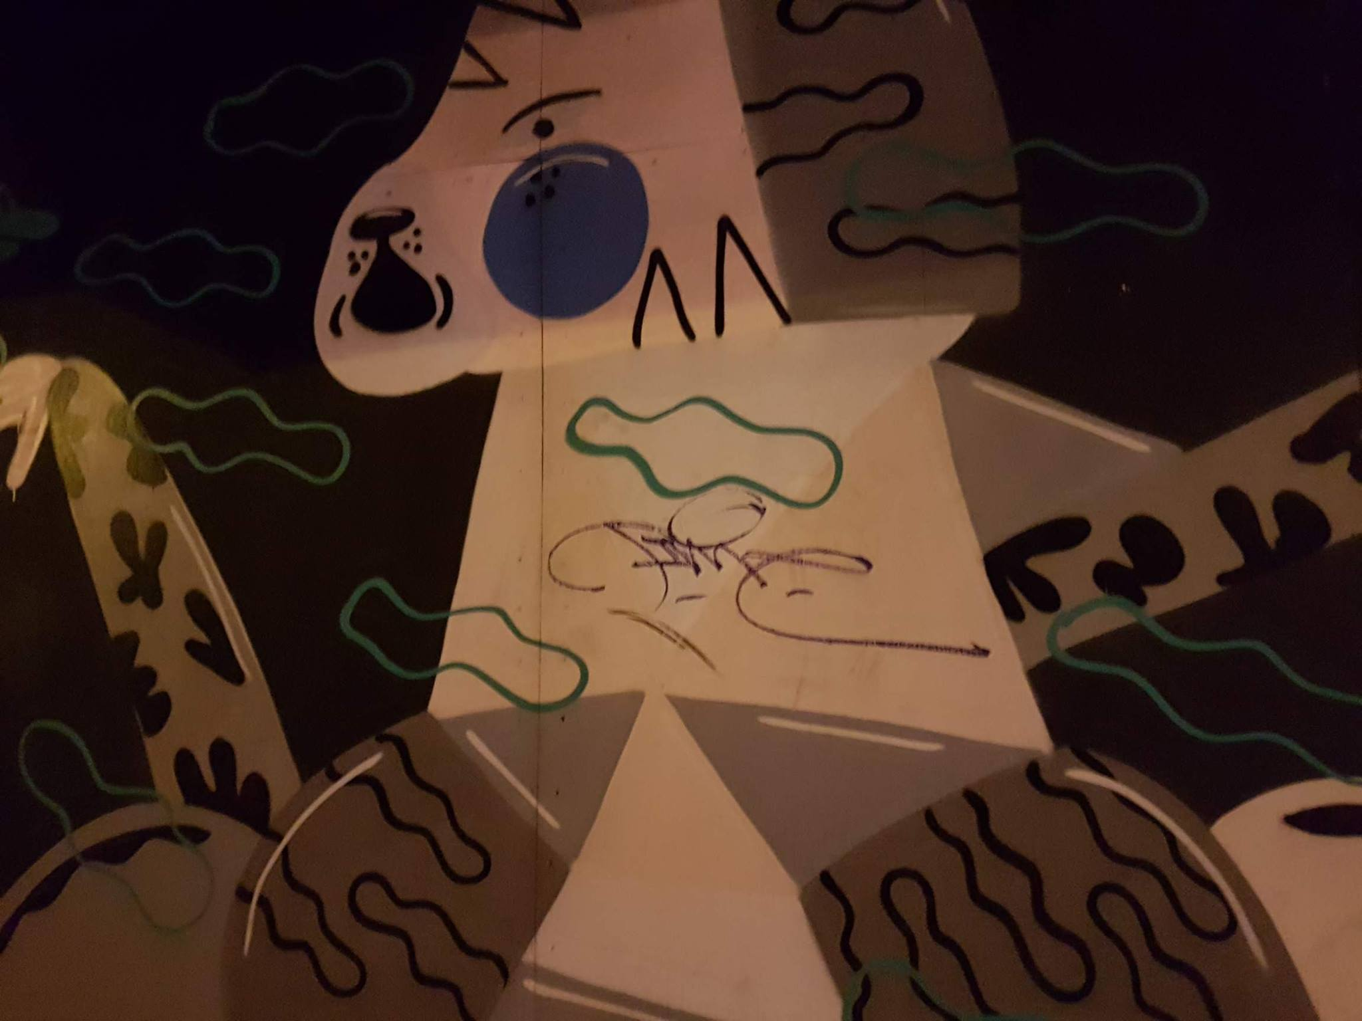
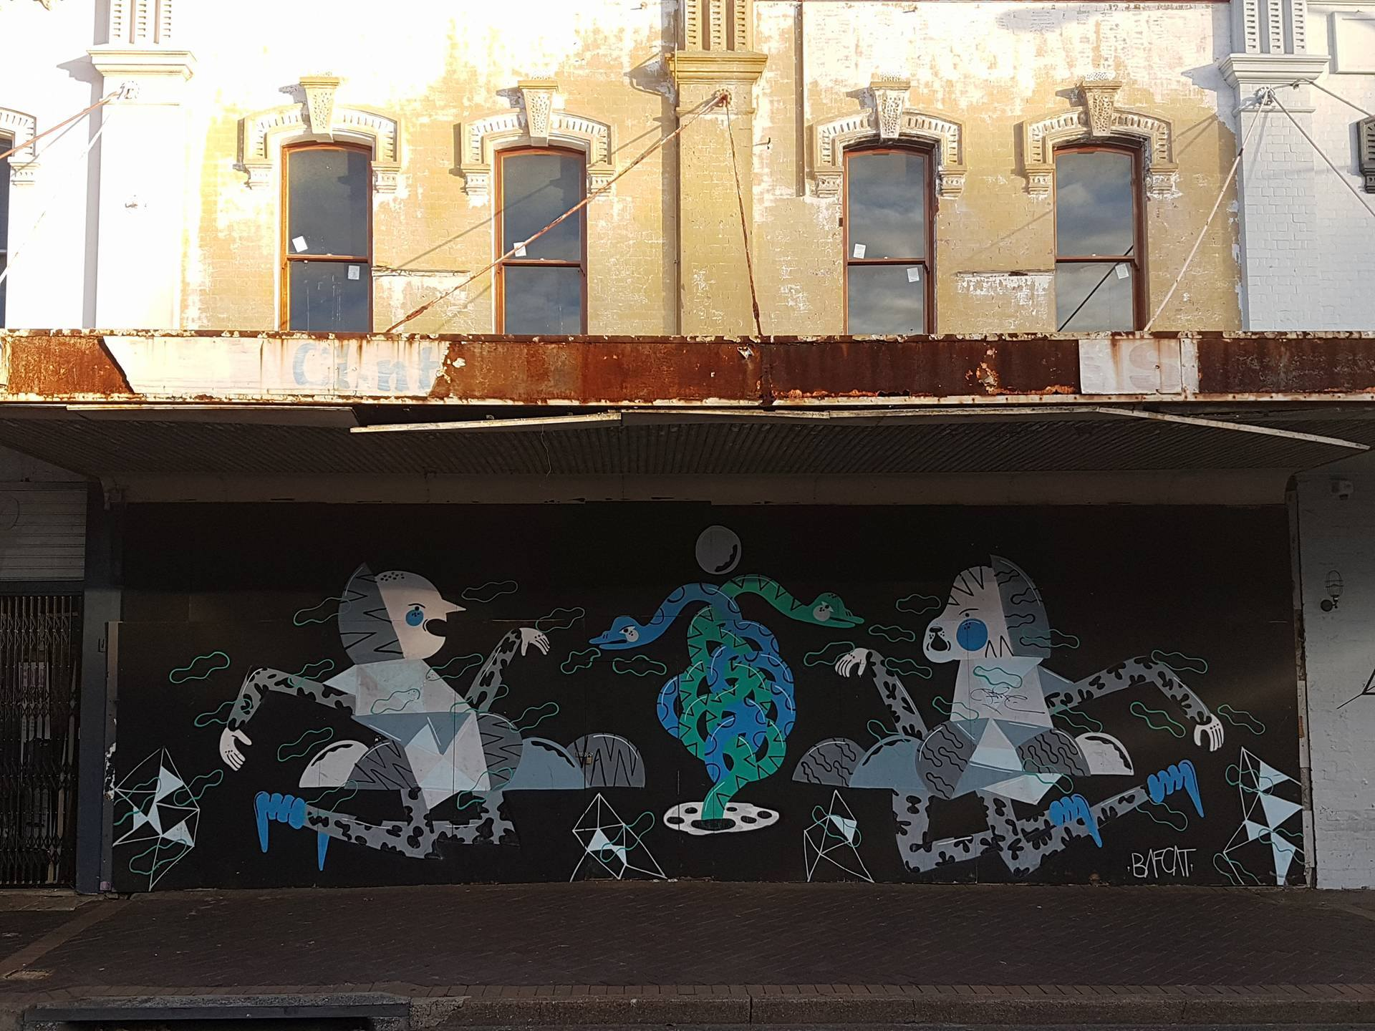
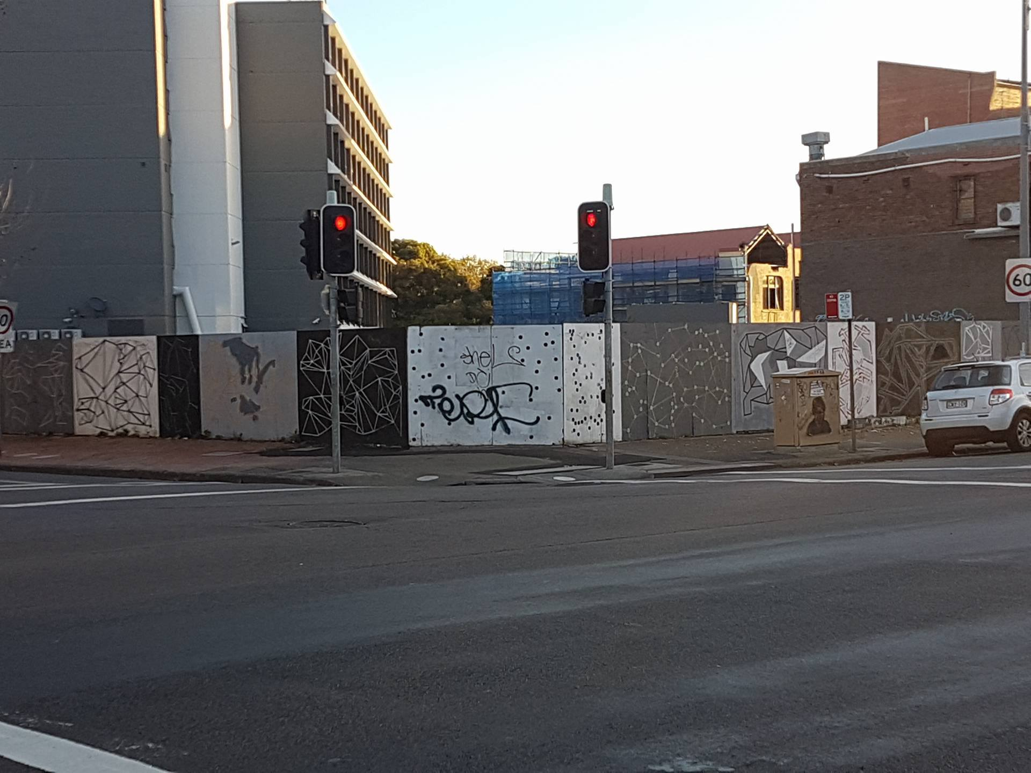
STREET ART WITH COOL COLORS IN PUBLIC AREA TEND TO HAVE MORE THAN ONE TAG
PICTURE 1: LOCATE IN NO. 11
PICTURE 2: LOCATE IN NO. 3

Slide 17
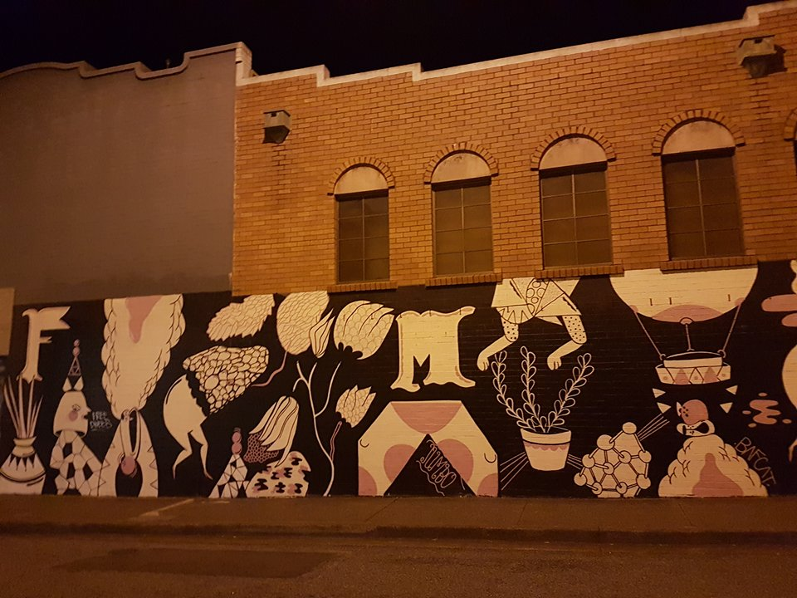
STREET ART WITH COOL COLORS IN PUBLIC AREA TEND TO HAVE MORE THAN ONE TAG
DIFFERENT ARTISTS LEAVE THEIR TAGS TO SHOW DOMINANCE?
5/7 OF LARGE MURAL IN PUBLIC AREA PAINTED WITH COOL COLOR CONTAIN MORE THAN ONE TAG.
PICTURE 1: LOCATE IN NO. 24

Slide 18
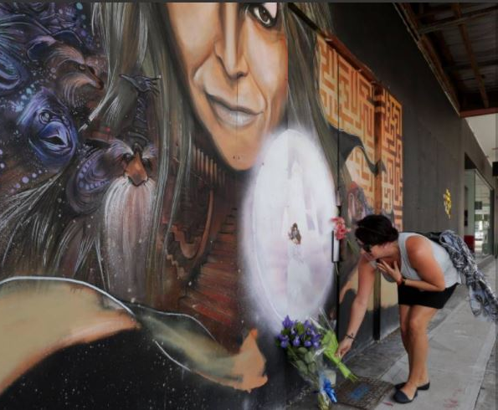
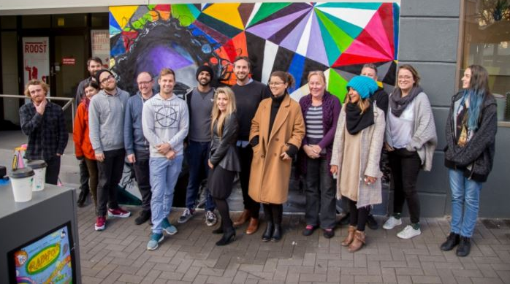
STREET ART WITH WARM COLORS TEND TO BE MORE WELCOMING AND APPRECIATED
DIAGRAM 2.3: SHOWING AREA OF WARM COLOR STREET ART IN HUNTER ST
PICTURE 2: LOCATE AT NO. 15 ^{[ 2 ]}
PICTURE 1 : LOCATE AT NO. 15 ^{[ 2 ]}
PICTURE 3: LOCATE AT NO. 25 ^{[ 7 ]}

Slide 19
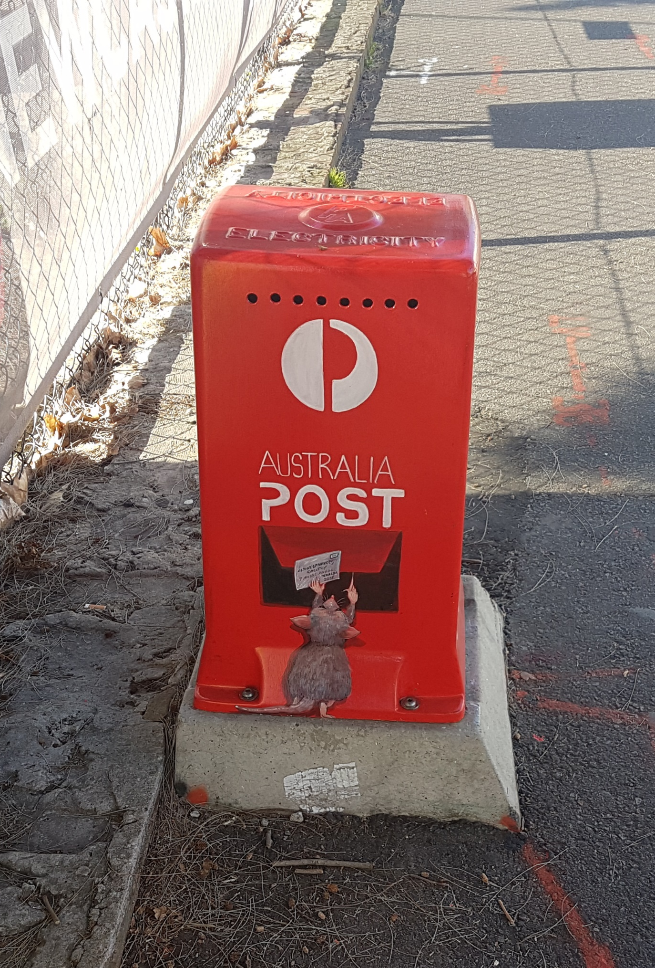
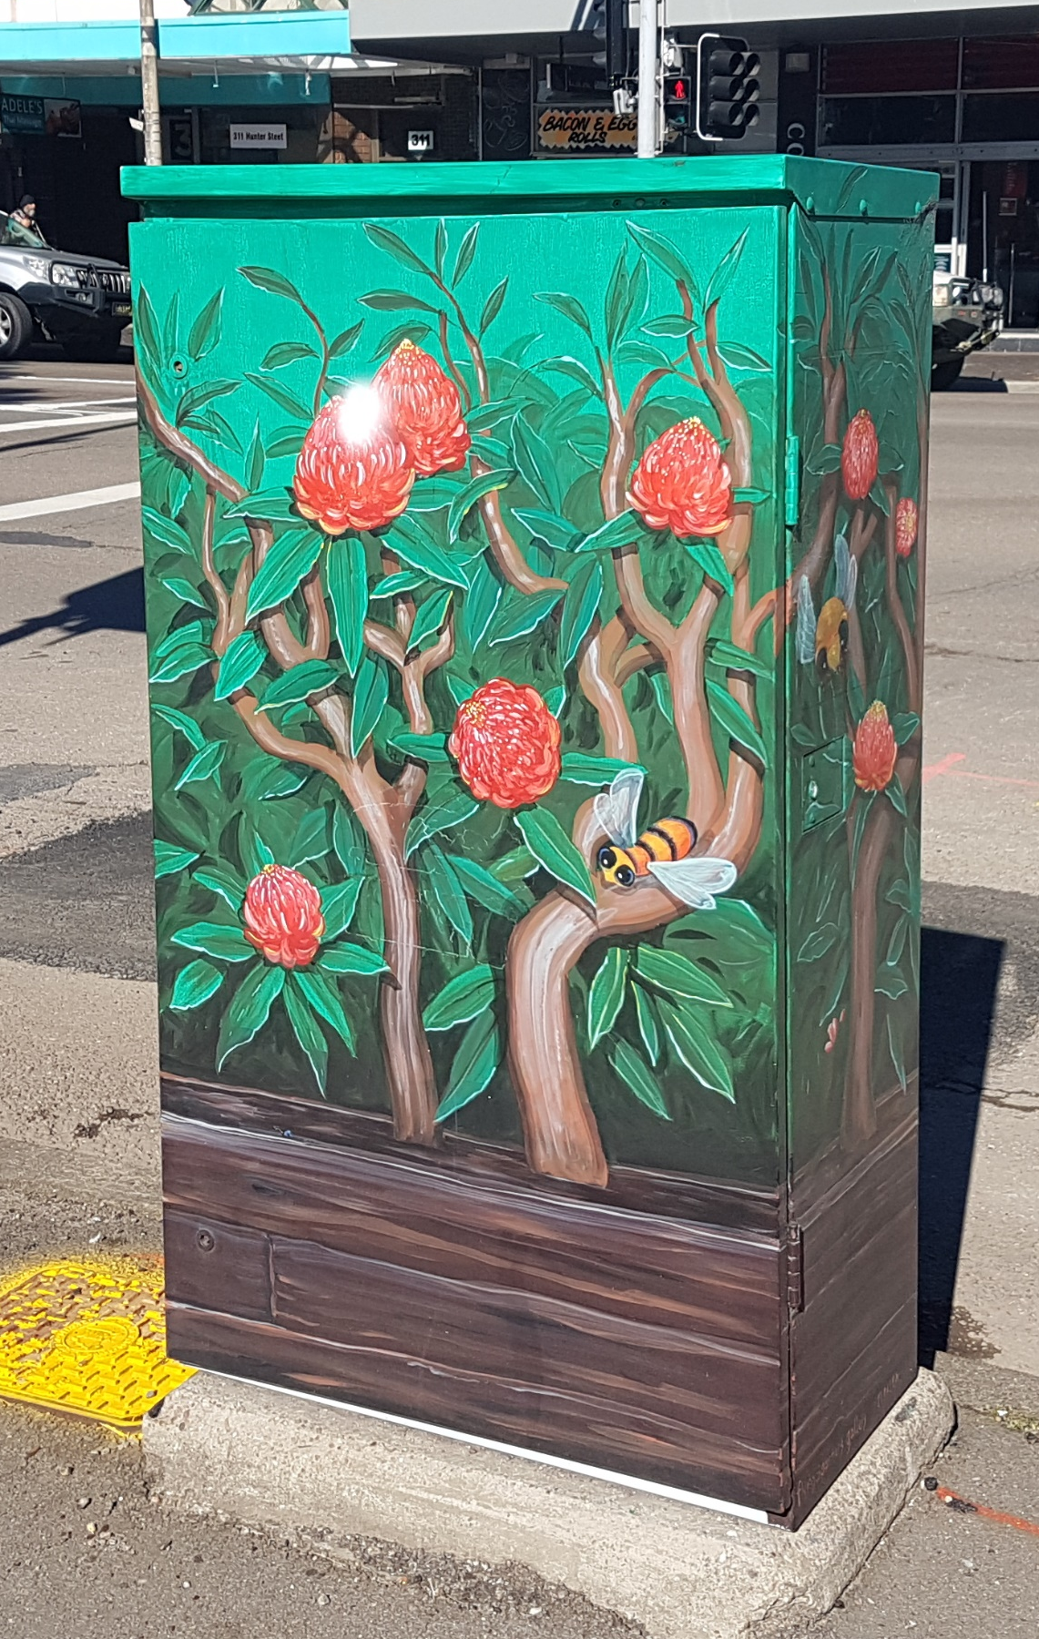
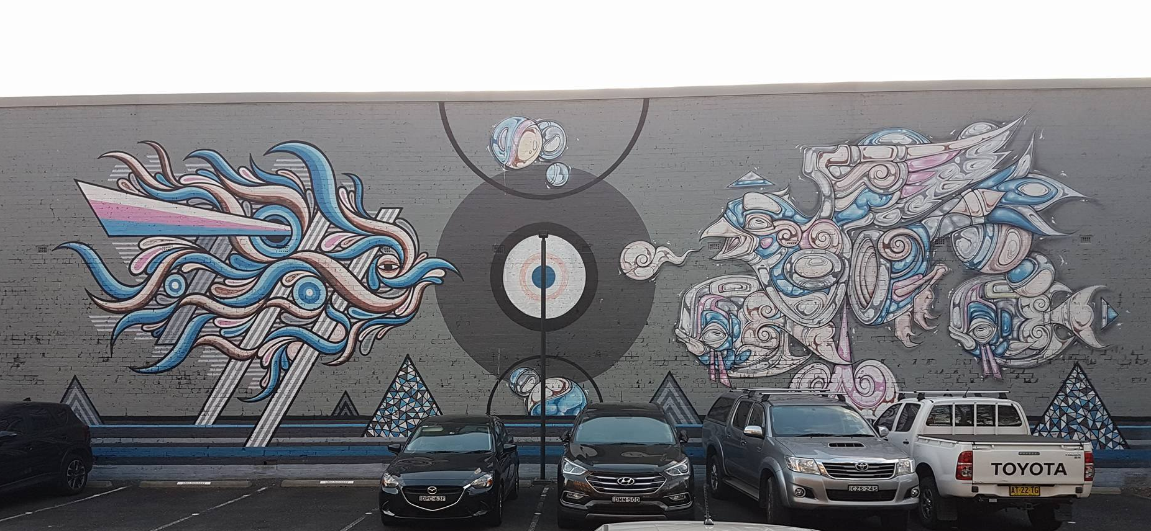
STREET ART WITH WARM COLORS TEND TO HAVE LESS THAN 2 TAGS OR EVEN NO TAG
PICTURE 1 : ‘’ NO. 6
PICTURE 1 : ‘’ NO. 18
PICTURE 1 : LOCATE AT NO. 8
PICTURE 1 : ‘’ NO. 20

Slide 20
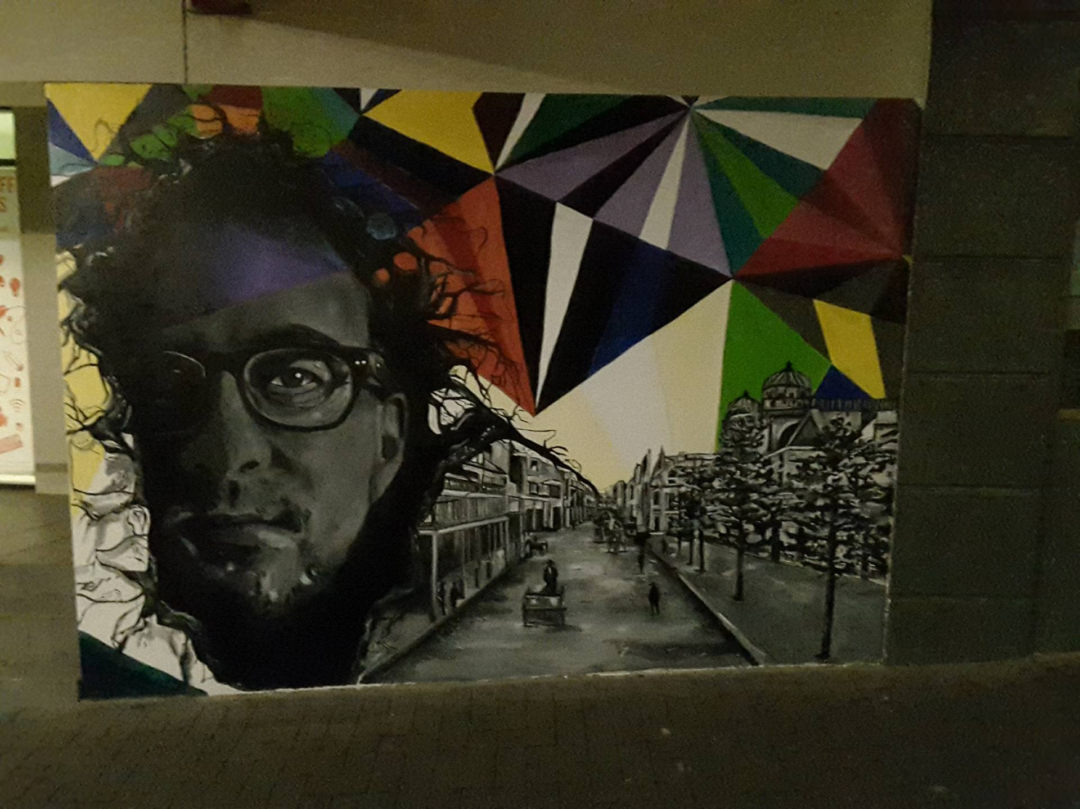
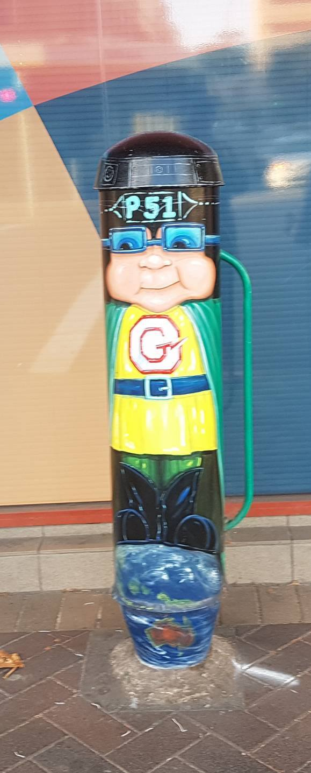
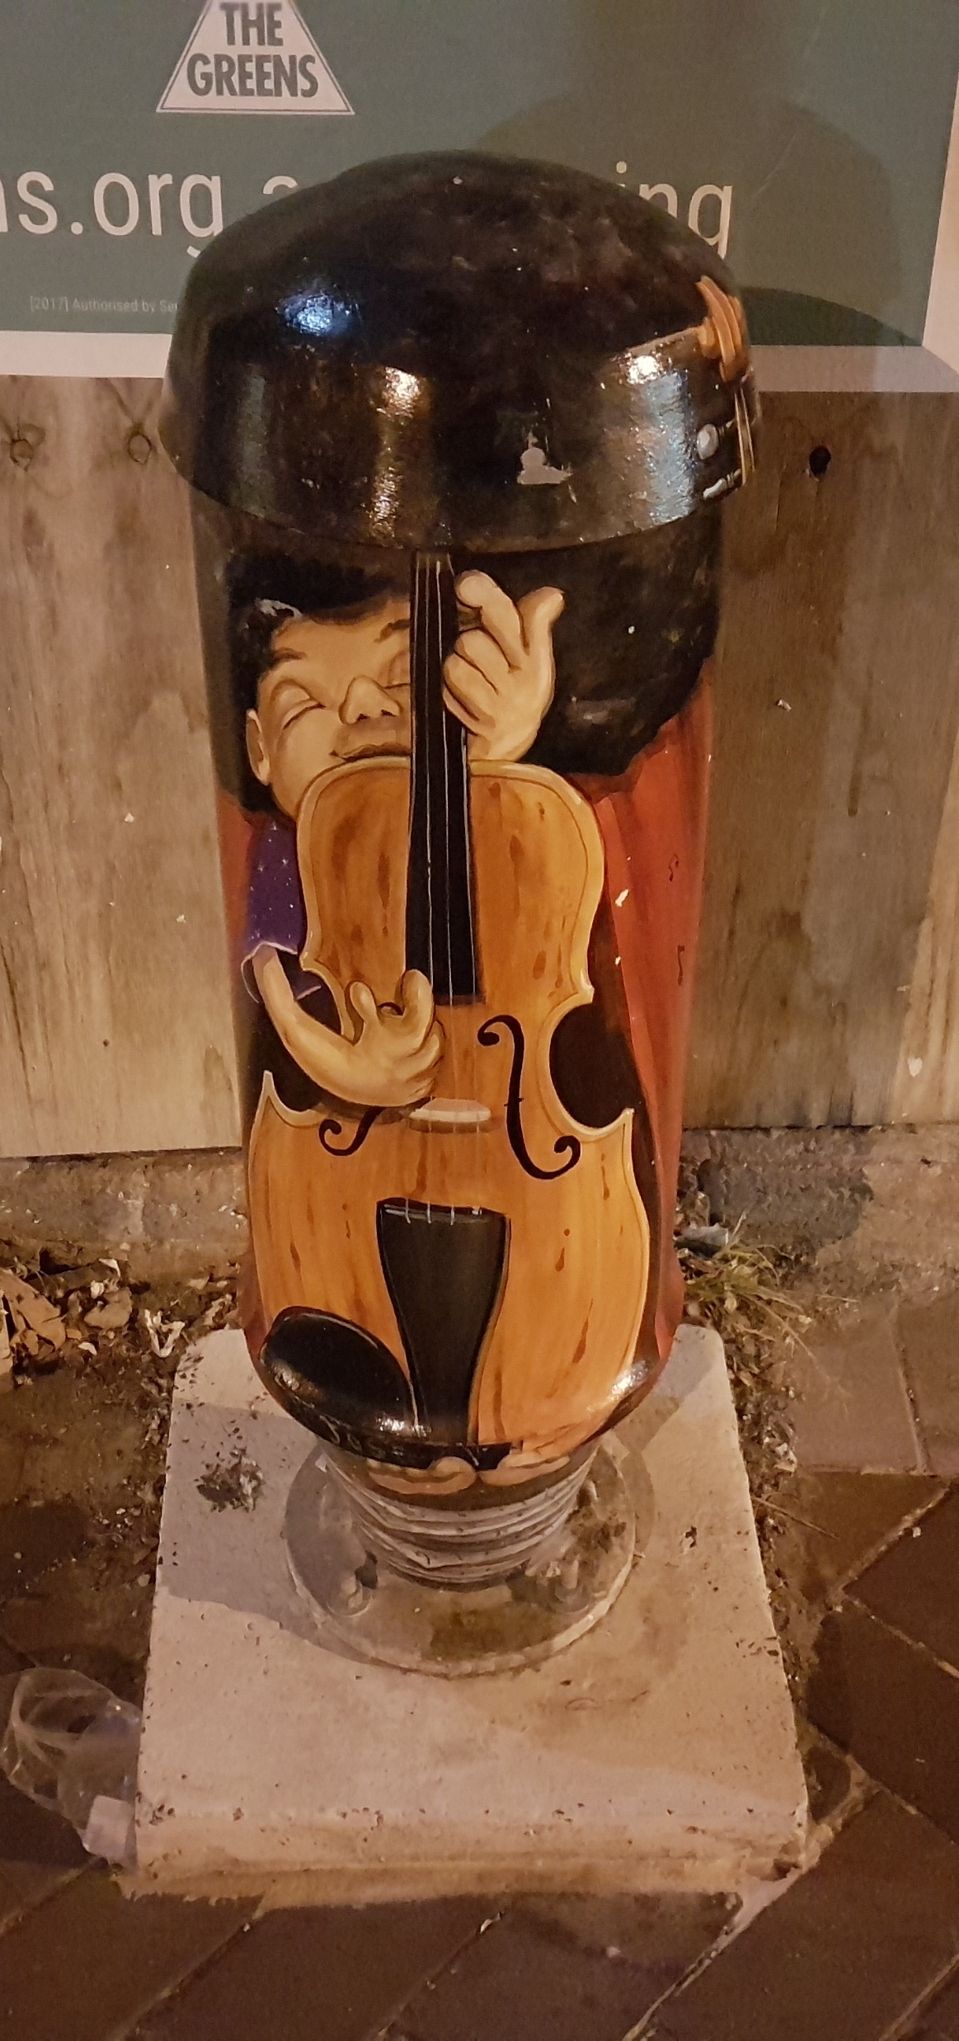
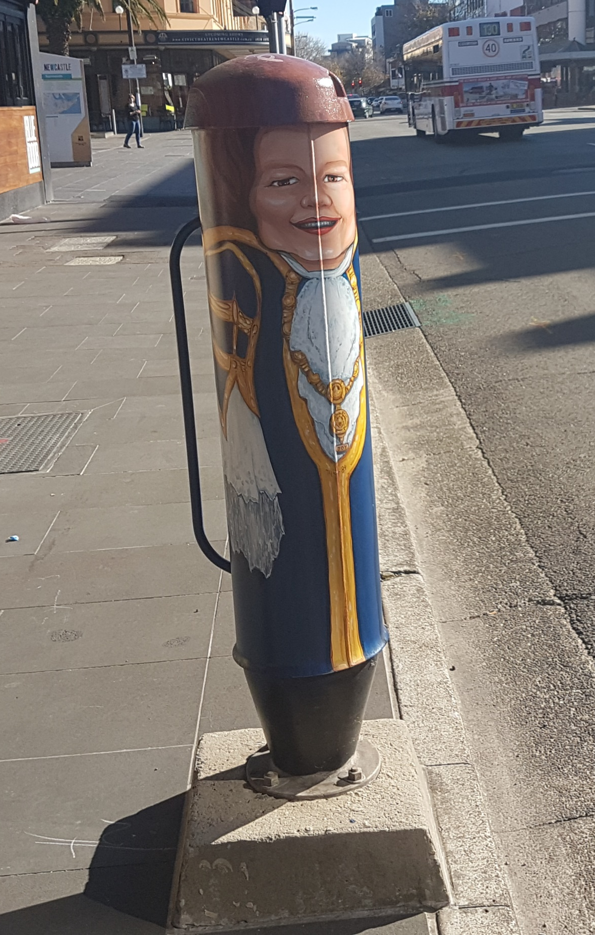
STREET ART WITH WARM COLORS TEND TO HAVE LESS THAN 2 TAGS OR EVEN NO TAG
6/6 OF LARGE MURAL IN PUBLIC AREA PAINTED WITH WARM COLOR CONTAIN NO TAG.
PICTURE 1 : ‘’ NO. 9
PICTURE 1 : ‘’ NO. 13
PICTURE 1 : LOCATE AT NO. 25
PICTURE 1 : ‘’ NO. 17

Slide 21
HYPOTHESIS
“MURAL PAINTED WITH COOL COLOR IN PUBLIC AREA ARE MOST LIKELY TO HAVE NEGATIVE IMPACTS ON STREET ART ARTIST & PEDESTRIAN THAN MURAL PAINTED WITH WARM COLOR.”

Slide 22
BIBLIOGRAPHY
A home to Roost — Renew Newcastle. (n.d.). Retrieved August 09, 2017, from
http://renewnewcastle.org/news/a-home-to-roost/
Beaumont, A. (2016, January 11). Bowie fans flock to mural. Retrieved August 09, 2017, from http://www.theherald.com.au/story/3659080/bowie-fans-flock-to-mural/#slide=1
B. (2017, March 01). The best street art in Melbourne: 11 laneways in the CBD you don't want to miss. Retrieved August 09, 2017, from http://thesweetwanderlust.com/wanderlust/melbourne-cbd-best-street-art/
Colorsystem. (n.d.). Retrieved August 09, 2017, from
http://www.colorsystem.com/?page_id=922&lang=en
Harrington, J. R. (2014, February 05). The Power of Color Via Street Art, Graffiti and Murals. Retrieved August 09, 2017, from http://www.huffingtonpost.com/jaime-rojo-steven-harrington/street-art-color_b_4726544.html
LEWISOHN, C. (2008). STREETART. MILLBANK, LONDON: TATE PUBLISHING.
Pakistani Artist unveils 8ft mural of a revitalised Newcastle in Hunter St Mall. (n.d.). Retrieved August 09, 2017, from https://theroostcreative.com.au/revitalised-hunter-st-mural/
14 Street Art Terms-Illustrated! (2013, July 10). Retrieved August 09, 2017, from
http://mentalfloss.com/article/51583/14-street-art-terms%E2%80%94illustrated

