Slide 1
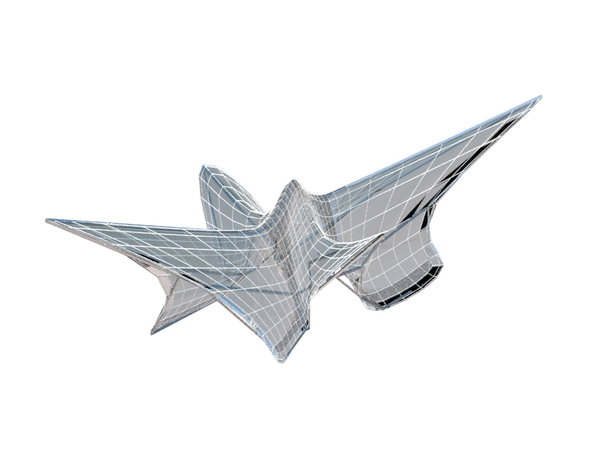

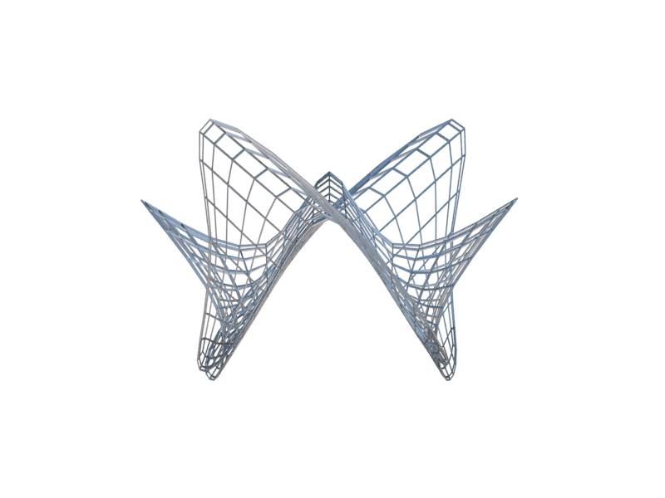
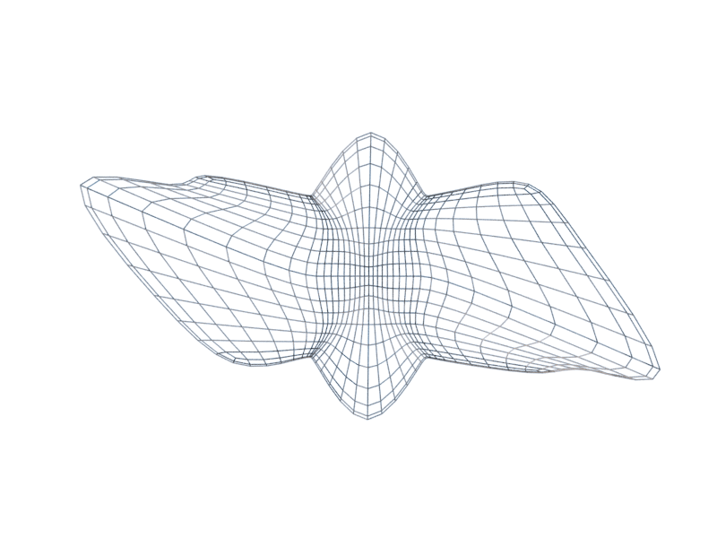
VA ESPORT ARENA
WEI PINK CHIA
MADE BY GAMING MOVEMENT

Slide 2
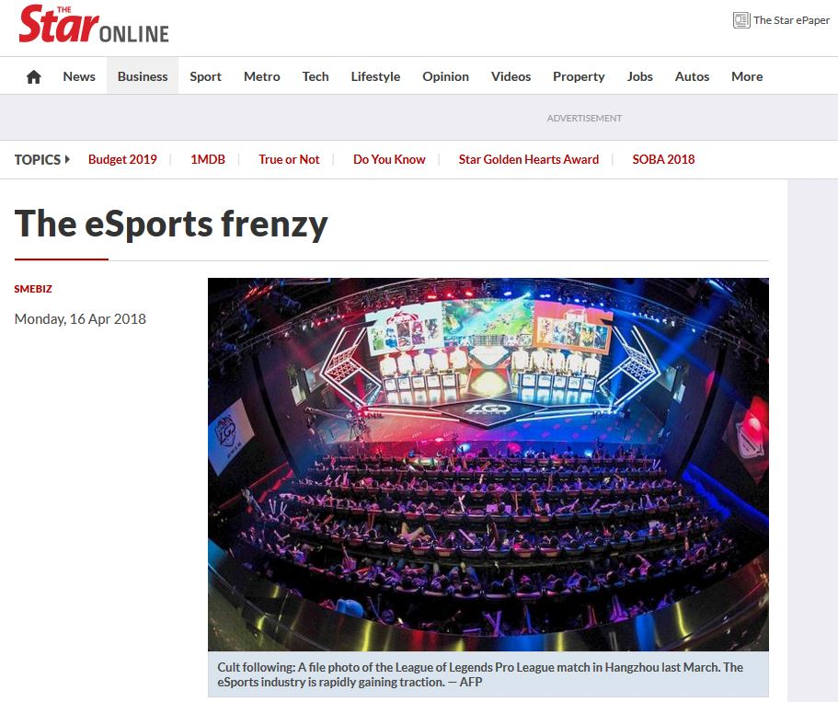
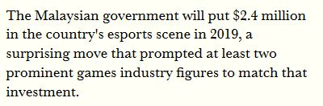
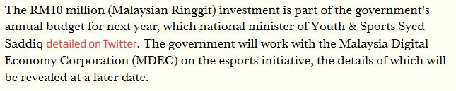

TARGETING ISSUE

Slide 3
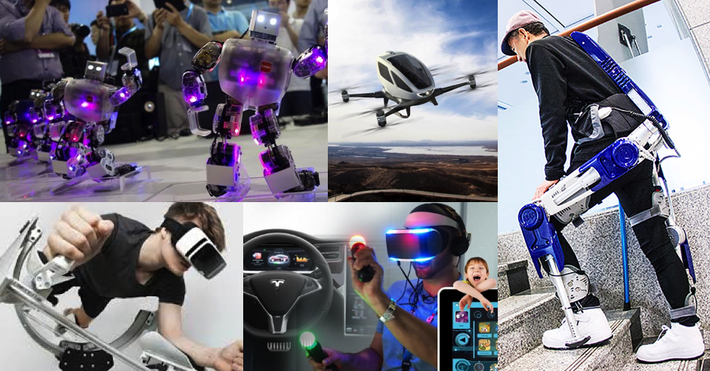
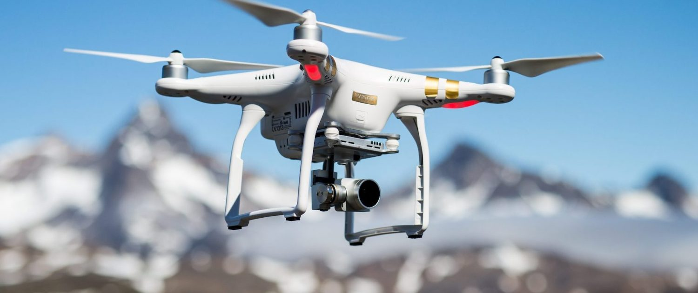
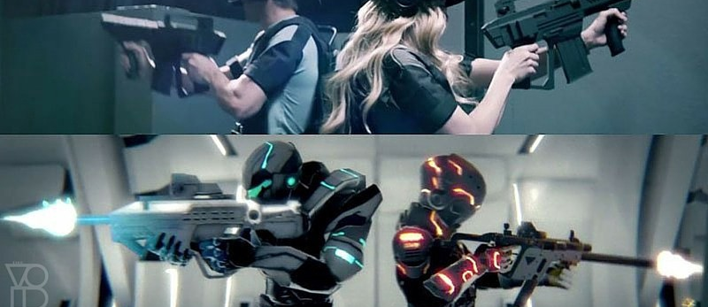
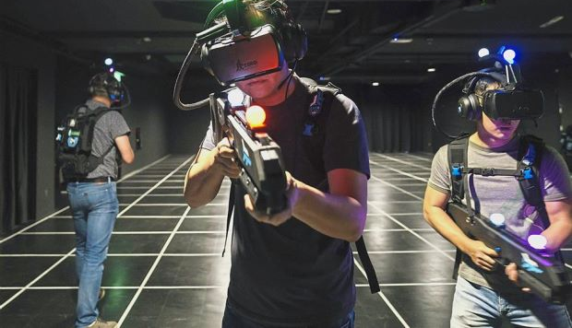
WHAT IS E-SPORT?
Whole new level of gaming

Slide 4
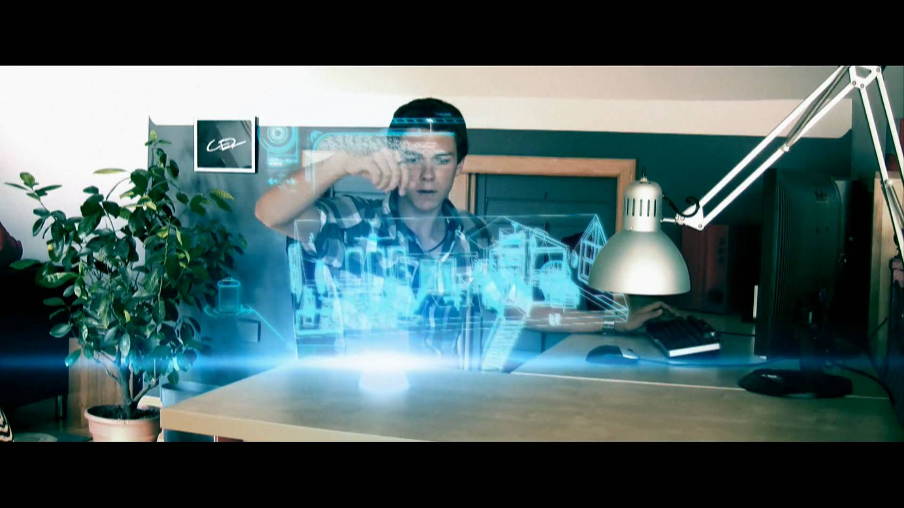

VIRTUAL ARCHITECTURE
AUGMENTED ARCHITECTURE
The technique of simulating 3-dimensional reality
Design process through simulation
A technology that “presents a virtual world that enriches, rather than replaces the real world.”

Slide 5
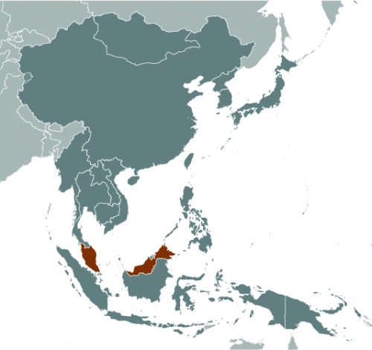
SITE ANALYSIS
CENTRAL BUSINESS DISTRICT
KUALA LUMPUR,
MALAYSIA

Slide 6
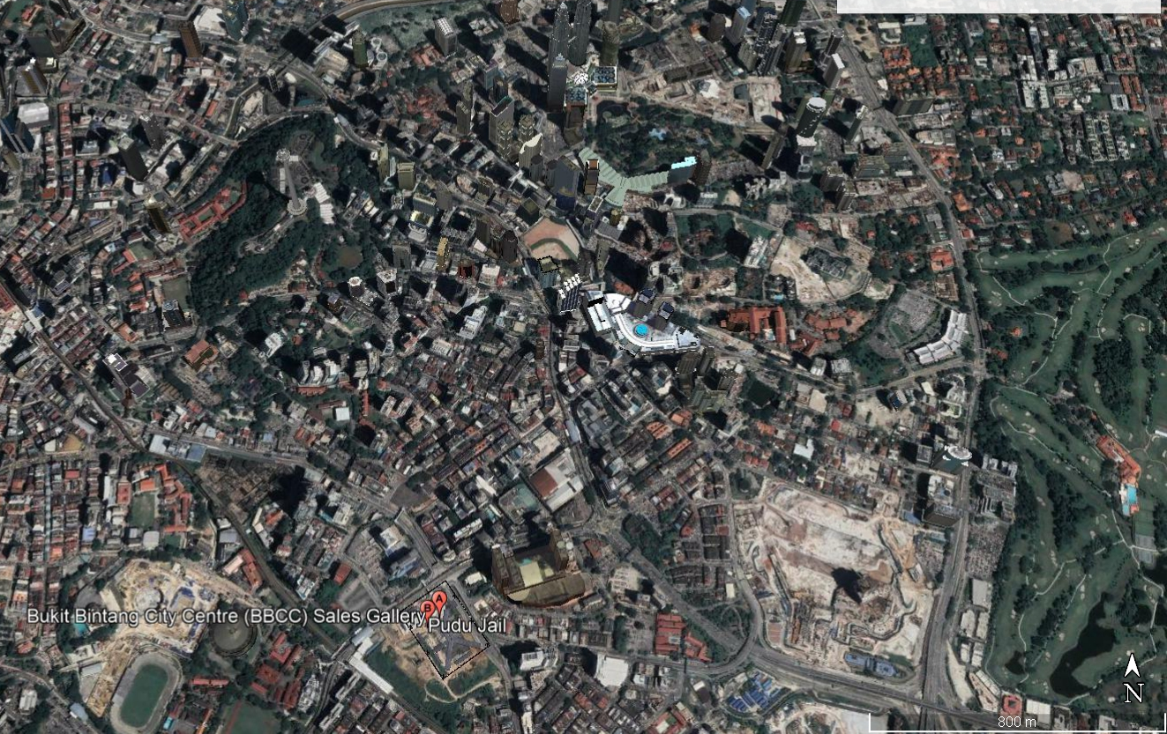
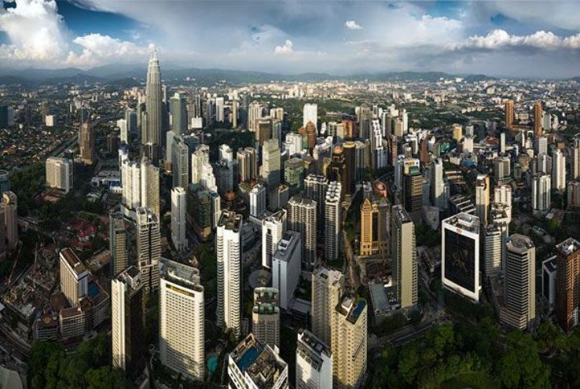
SITE ANALYSIS
CENTRAL BUSINESS DISTRICT

Slide 7
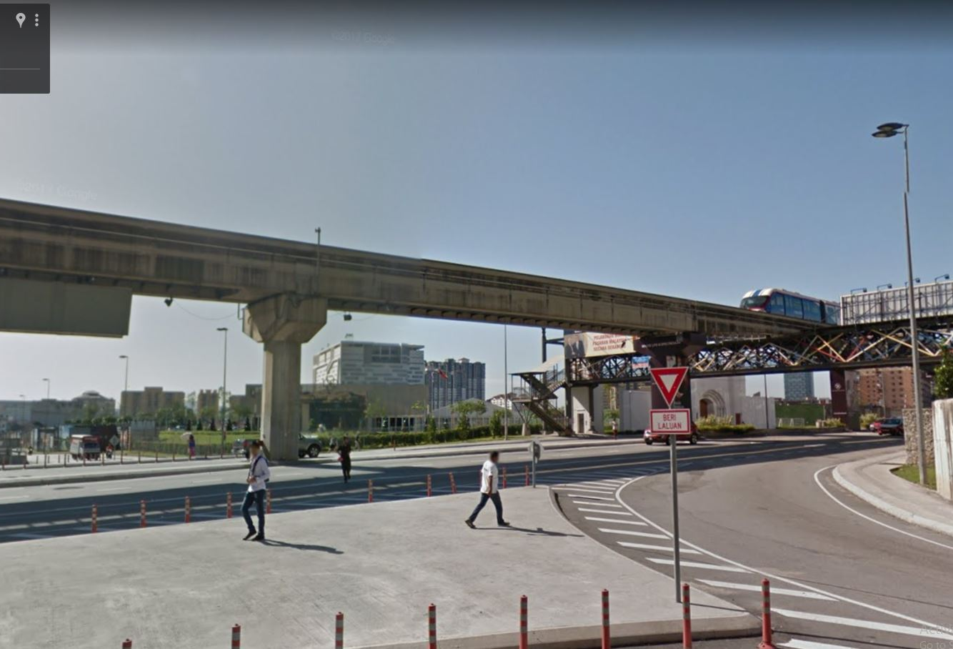
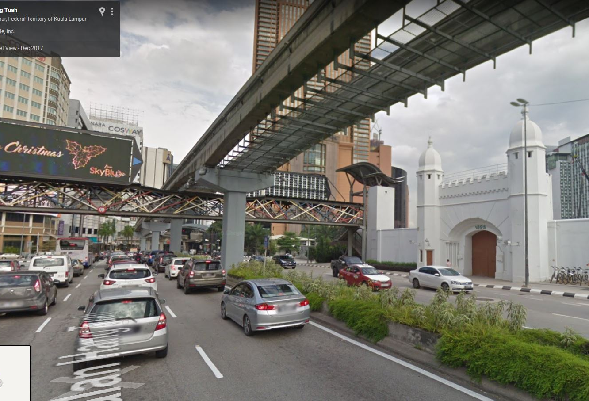
PUDU JAIL TODAY
PUDU JAIL, KUALA LUMPUR, MALAYSIA

Slide 8
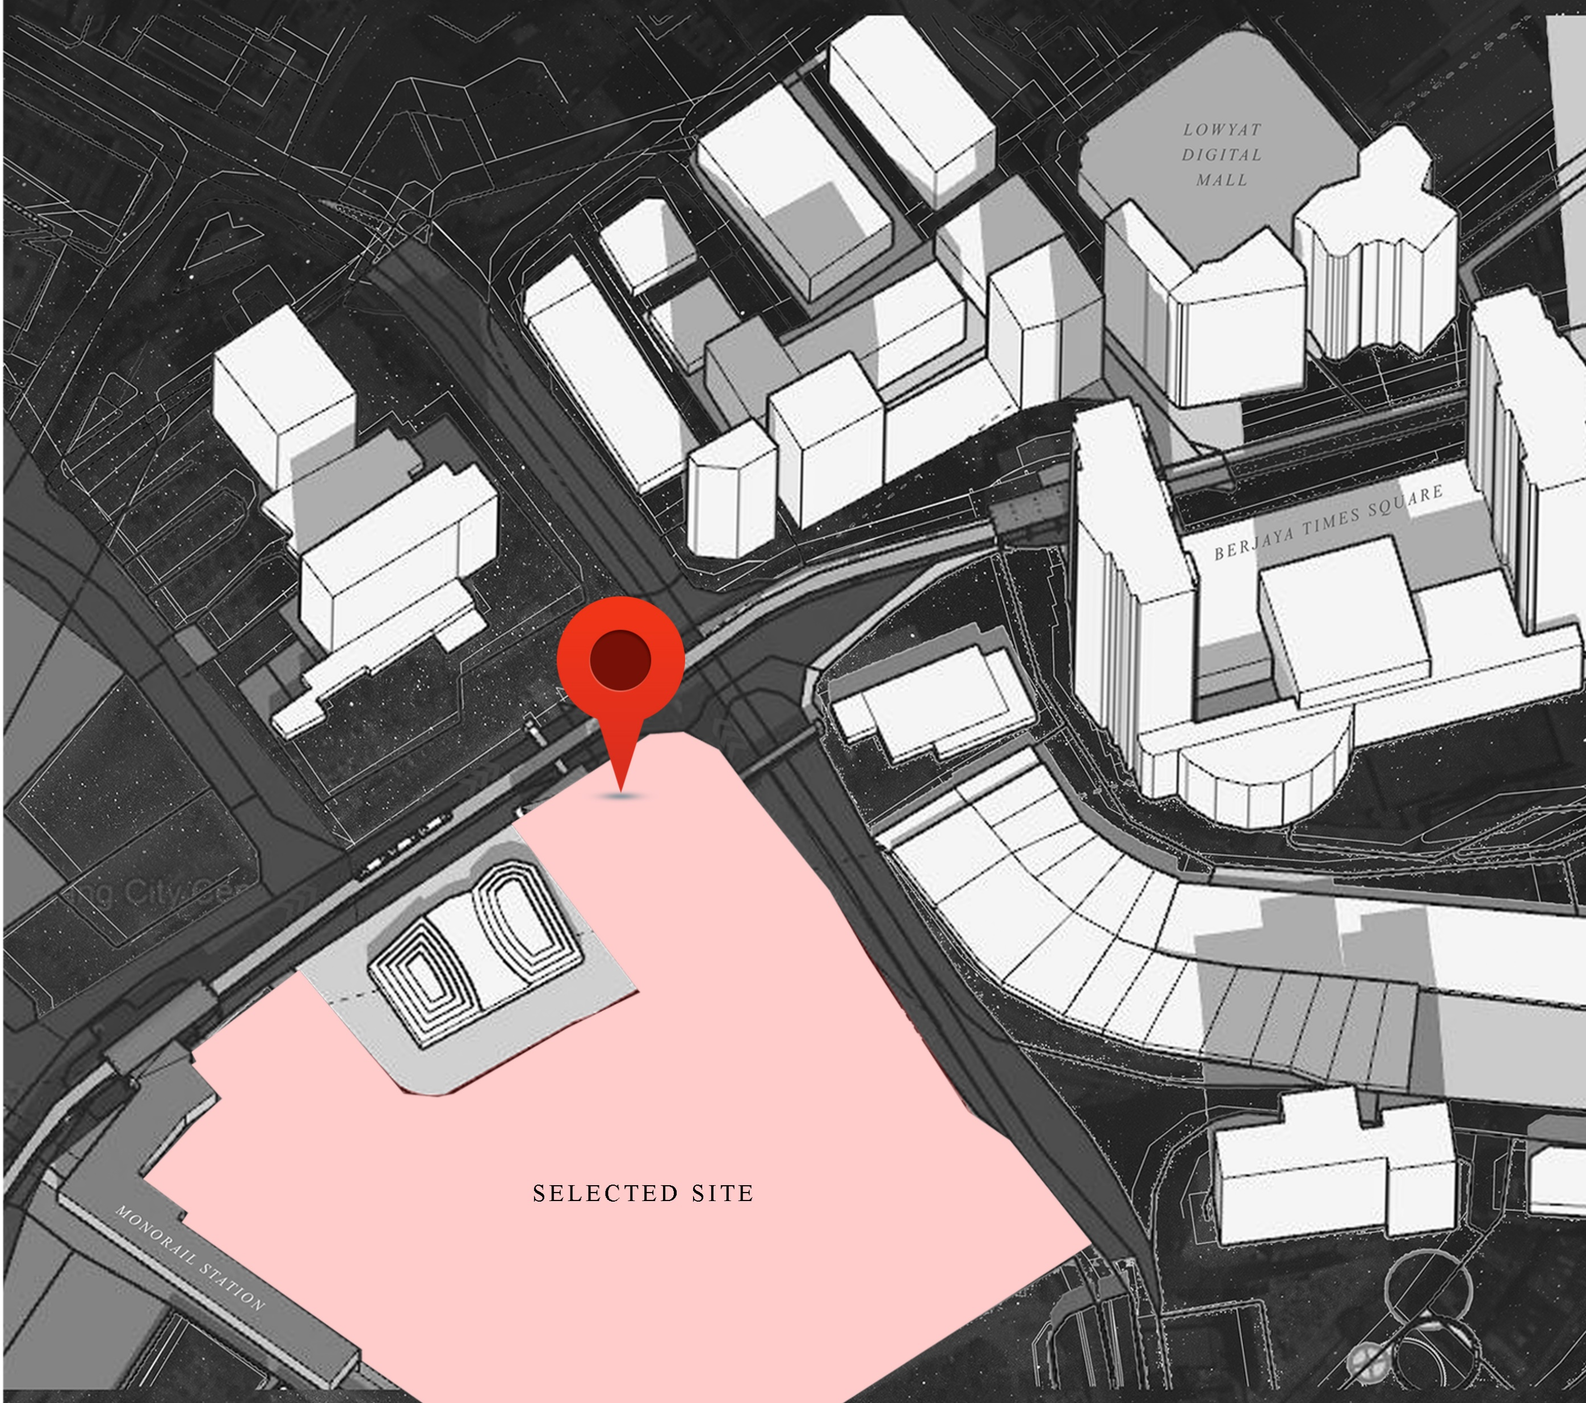
SELECTION OF SITE

Slide 9
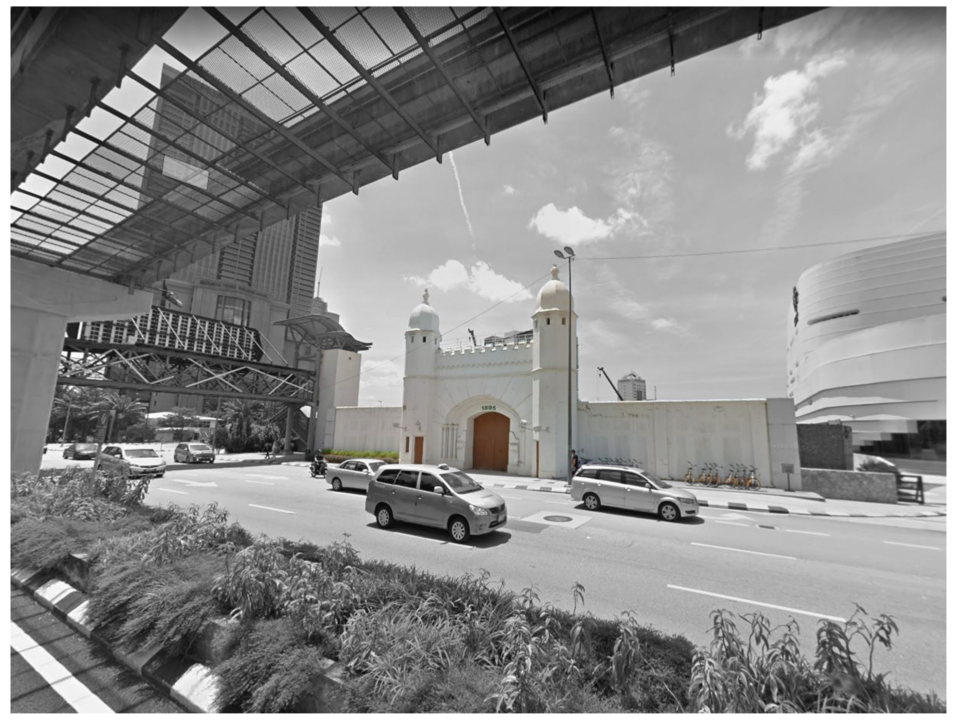
EXISTING
PUDU JAIL, KUALA LUMPUR, MALAYSIA
TODAY

Slide 10
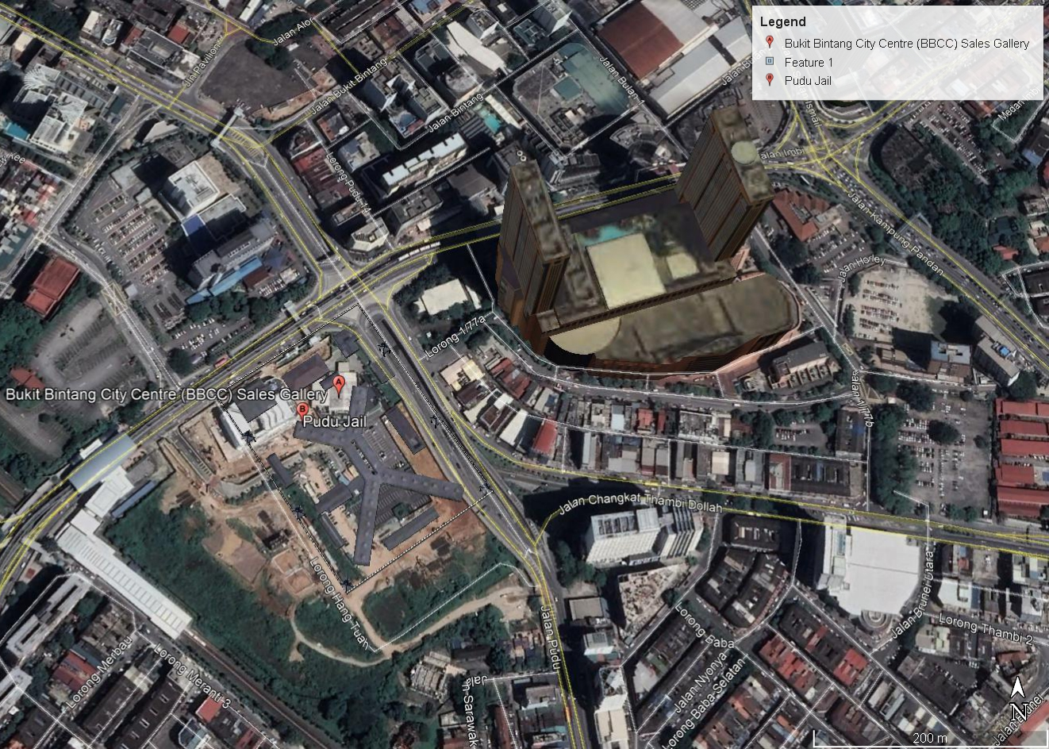
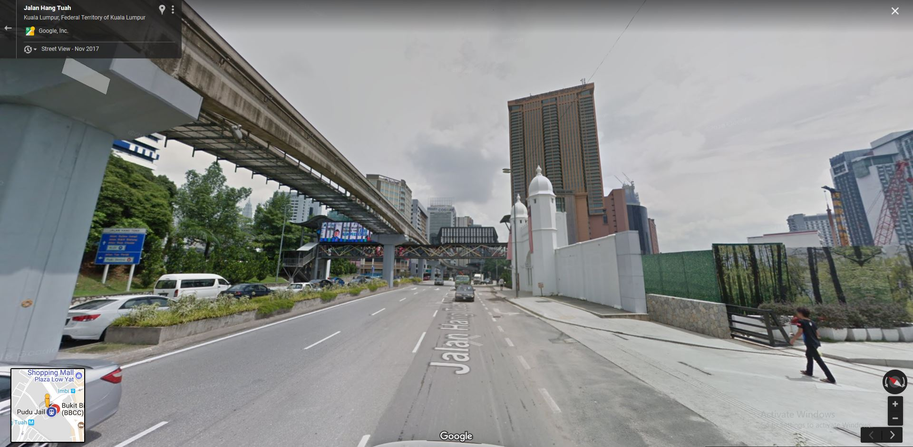
STRENGTH
GOOD CENTRAL DISTRICT
MANY RECREATIONAL FACILITIES LIKE SHOPPING MALLS SURROUNDING THE SITE
EXISTING HERITAGE ENTRANCE
EXISTING ROAD & CARPARK
LRT STATION & MONORAIL ROUTE SORROUNDING THE SITE

Slide 11
OPPORTUNITY
LOWYAT DIGITAL MALL
: BUSINESS OPPORTUNITY, HAVING A PRE-DISPLAY OF LATEST GADGET
TIMES SQUARE SHOPPING MALL
: POTENTIALLY BRINGING CROWD FROM THE MALL
ROAD INTERSECTION
: DRAW DRIVER & PASSENGER ATTENTION DUE TO ITS HIGH DENSITY TRAFFIC
LANDMARK :
POTENTIALLY BECOME A NEW LANDMARK FOR THE AREA
LRT STATION :
POTENTIALLY DRAWING PEDESTRIAN ATTENTION

Slide 12
Design Concept & Development

Slide 13
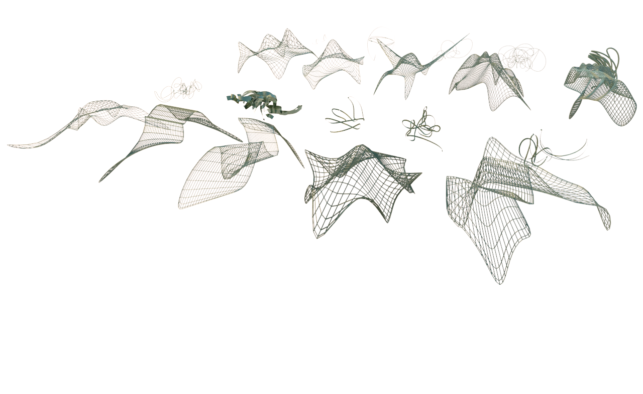
DIGITAL TECHNOLOGY IN ARCHITECTURE
“The rise of spatial modelling & form creation techniques enables architects to deal with forms that previously could barely drawn or built.”

Slide 14
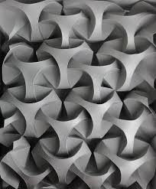
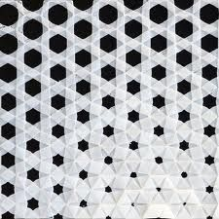
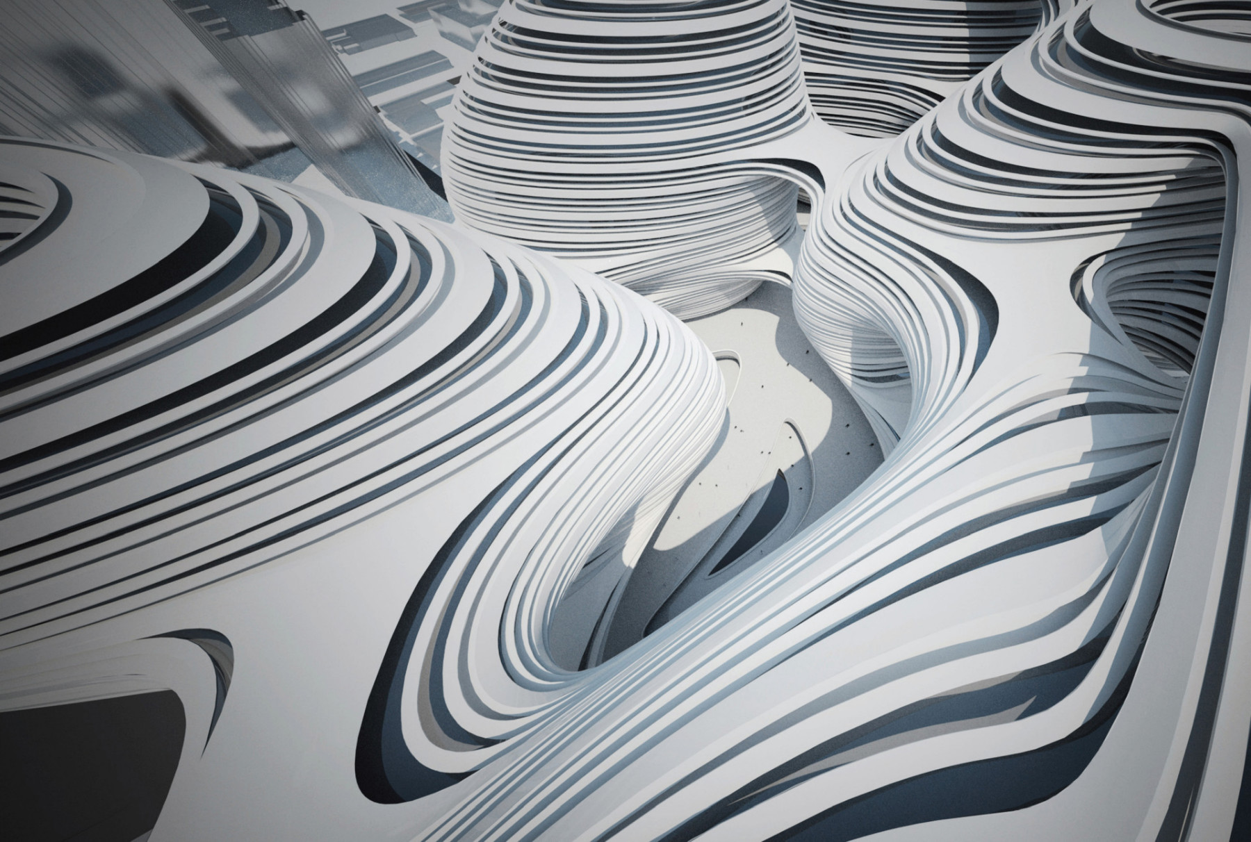
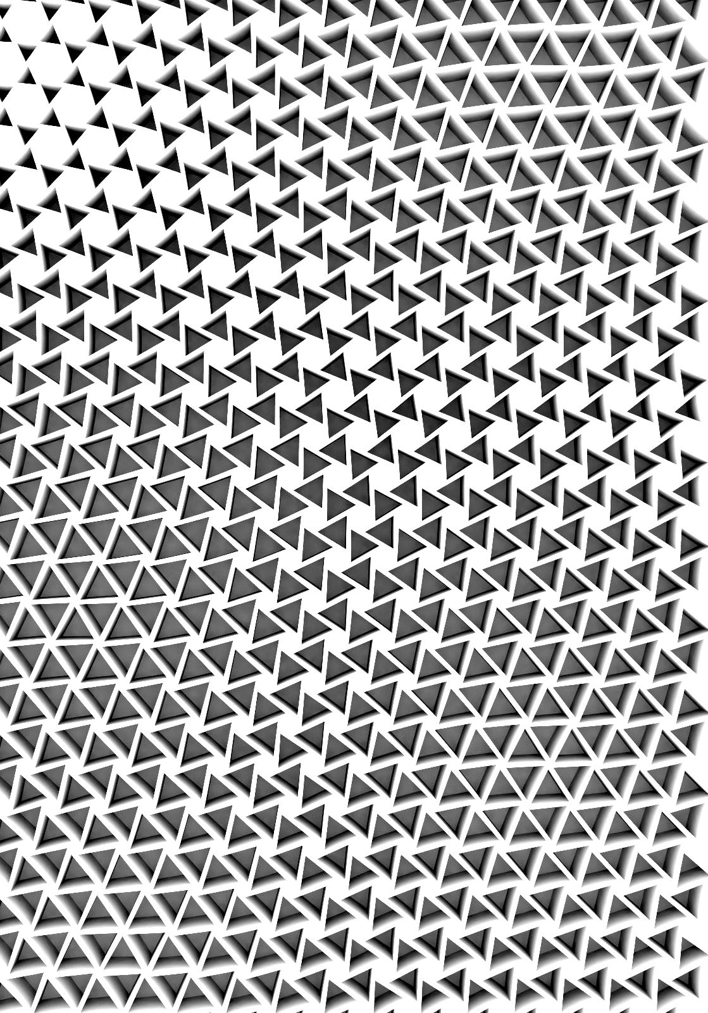
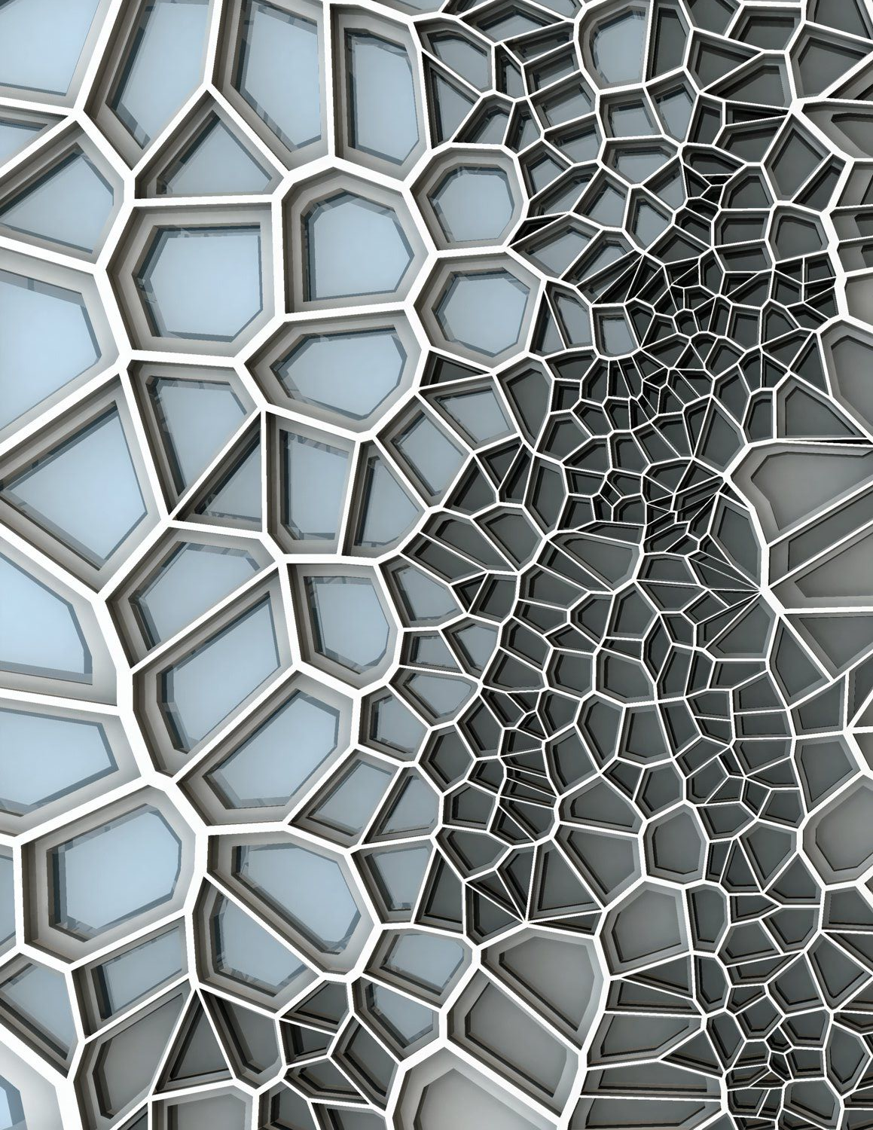
DIGITAL TECHNOLOGY IN ARCHITECTURE
“Generative design is a design method in which the output – image, sound, architectural models, animation – is generated by a set of rules or and algorithm, normally by using a computer program. Most generative design is based on parametric modelling.”
-A means of creating VARIATIONS.

Slide 15
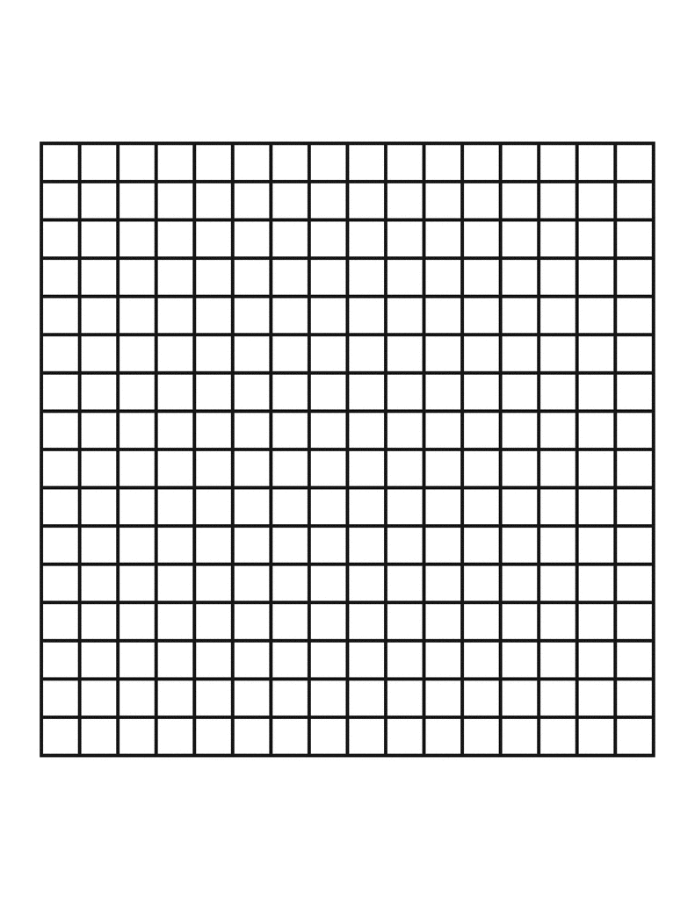
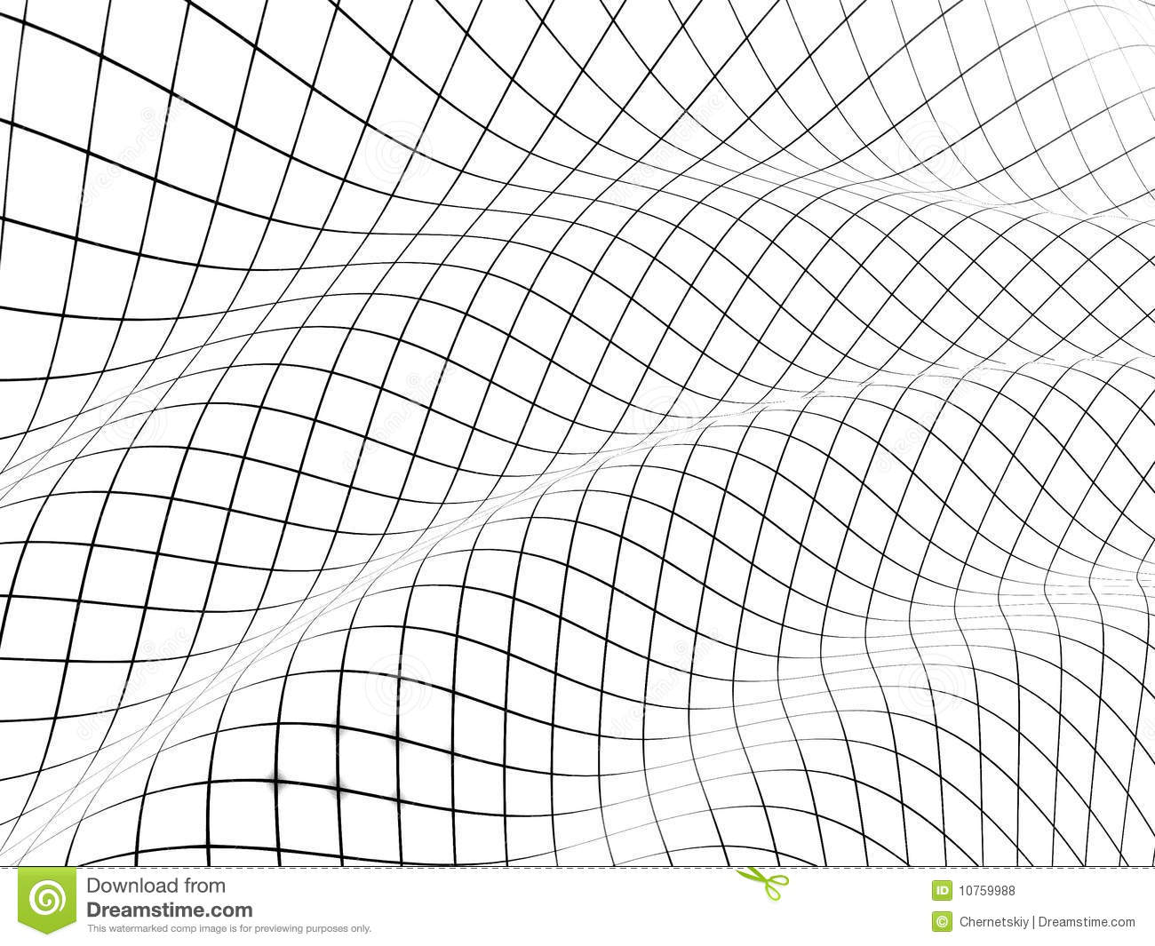
EXPLORATION OF PARAMETRIC ARCHITECTURE IN 2 DIMENSIONAL & 3 DIMENSIONAL
HOW TO MAKE THINGS LOOK 2DIMENSION & 3DIMENSION AT THE SAME TIME?
CAN VIRTUAL REALITY HELP TO DESIGN ARCHITECTURE?
NET FORM –DIFFERENT POINT HAS VARIATIONS IN HEIGHT & COORDINATES
TOP VIEW
SIDE VIEW

Slide 16
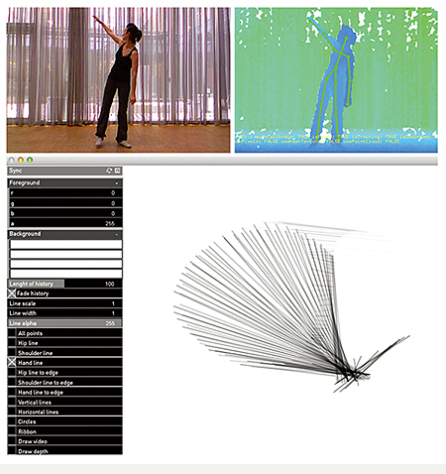
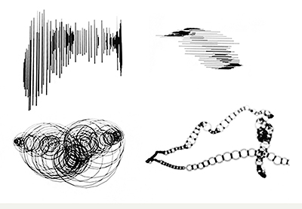
MATERIALIZING MOVEMENT —DESIGNING FOR MOVEMENT-BASED DIGITAL INTERACTION
Hansen, L. A., & Morrison, A (2014).
Institute of Design, The Oslo School of Architecture and Design, Norway
OBJECTS CREATED FROM HUMAN MOVEMENT
LINKING DOTS > FORMING LINES > GENERATE OBECTS

Slide 17
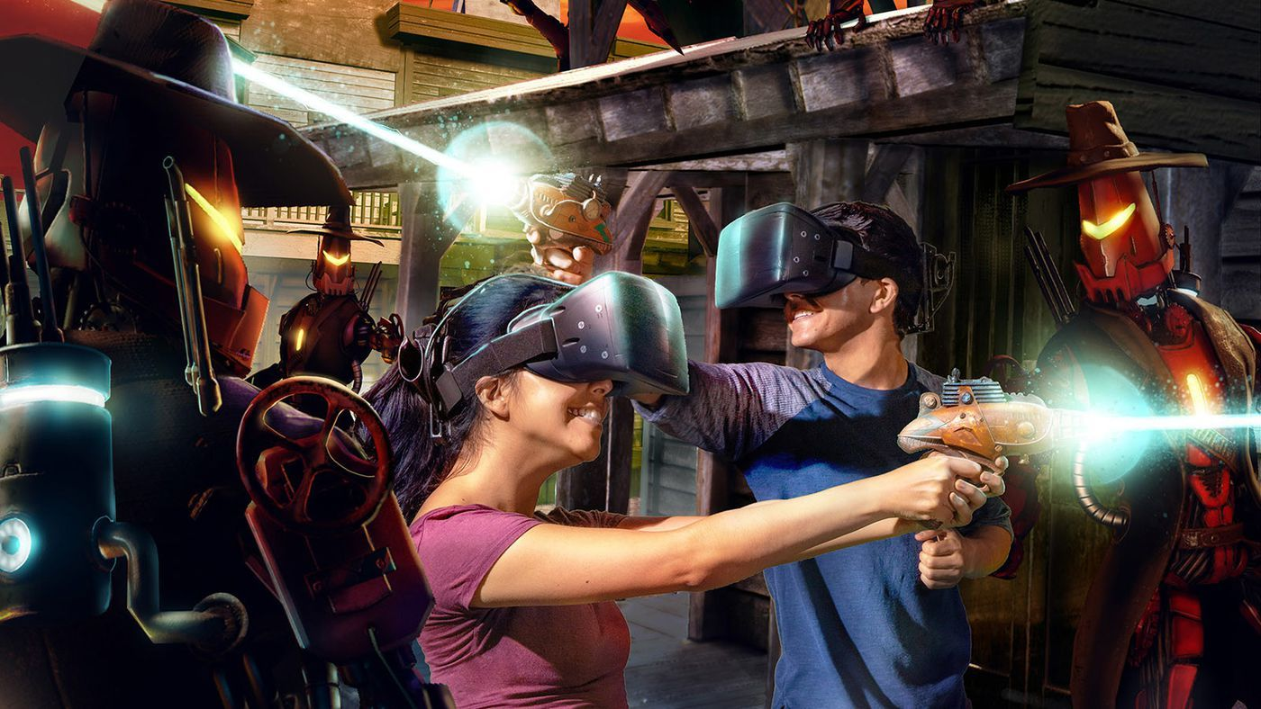

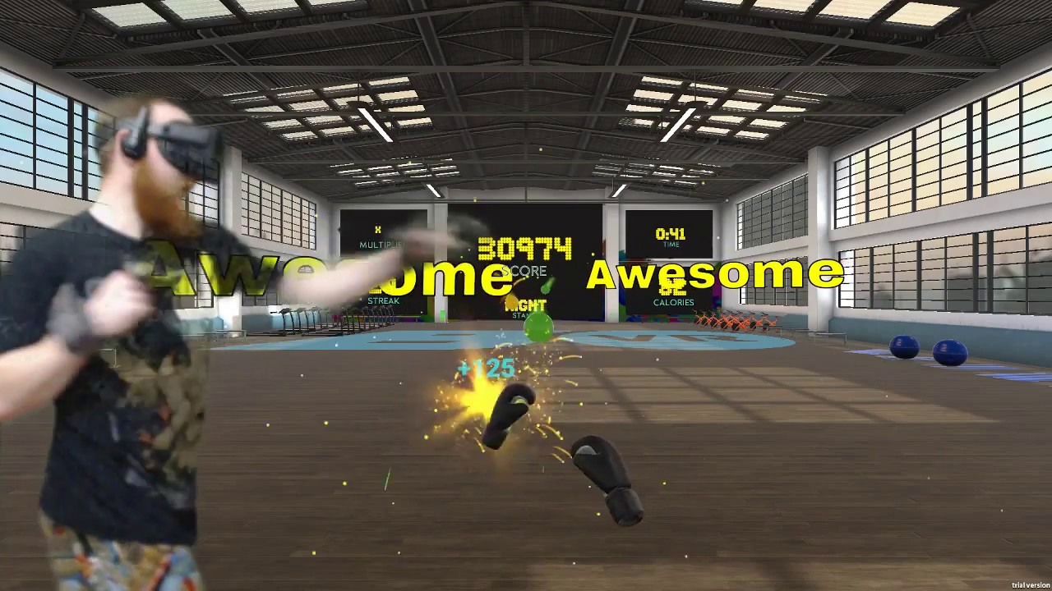
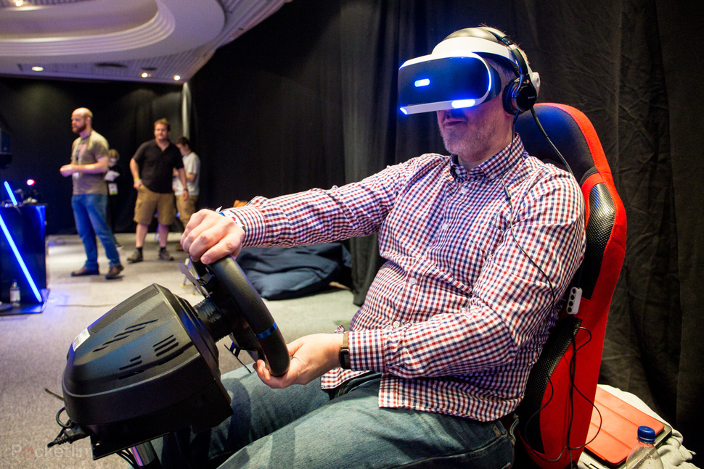
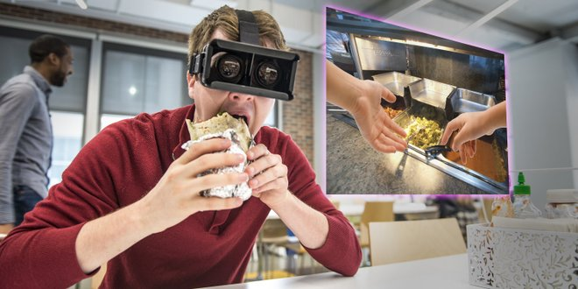
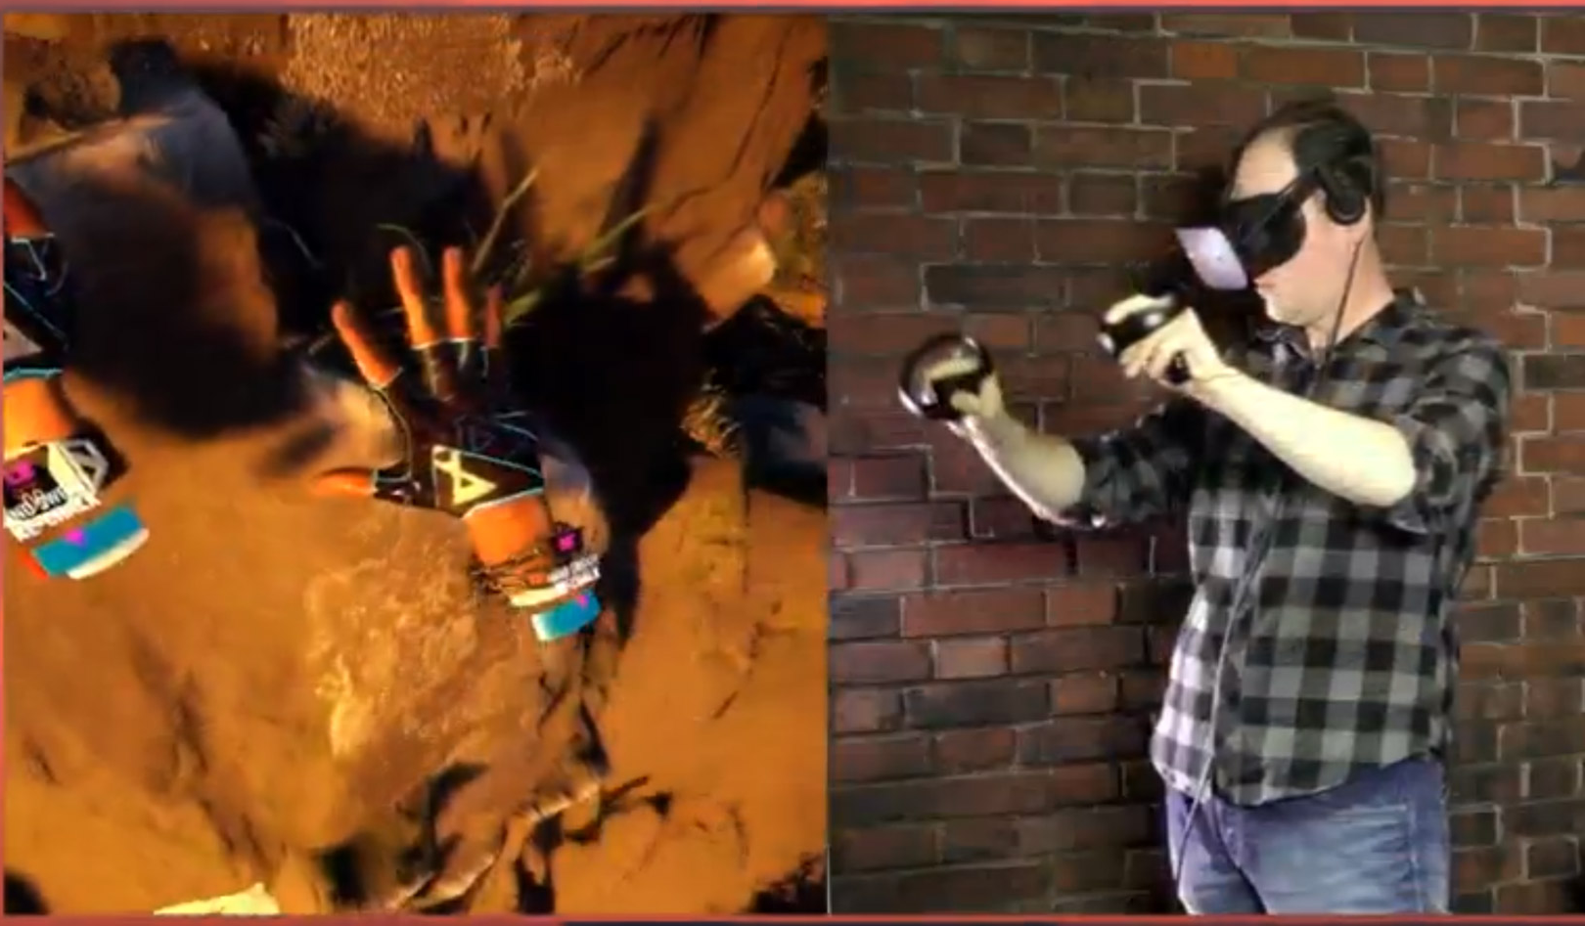

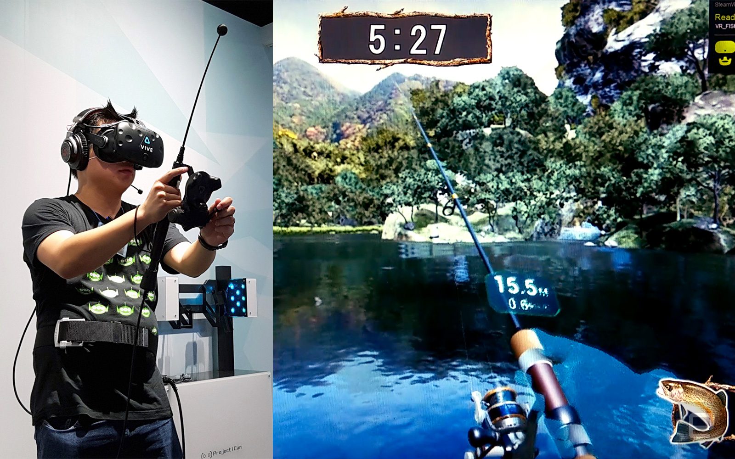
SHOOTING
SWORD FIGHTING
BOXING
DRIVING
FORM INSPIRED FROM “GAMING” MOVEMENT
EATING / FOOD SERVICING
CLIMBING MOUNTAIN
RIDING ROLLER COASTER
FISHING

Slide 18
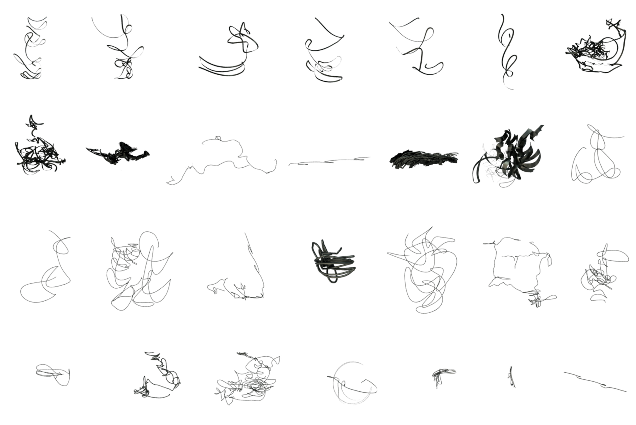
MOVEMENT SKETCHES COLLECTED FROM GAMING

Slide 19
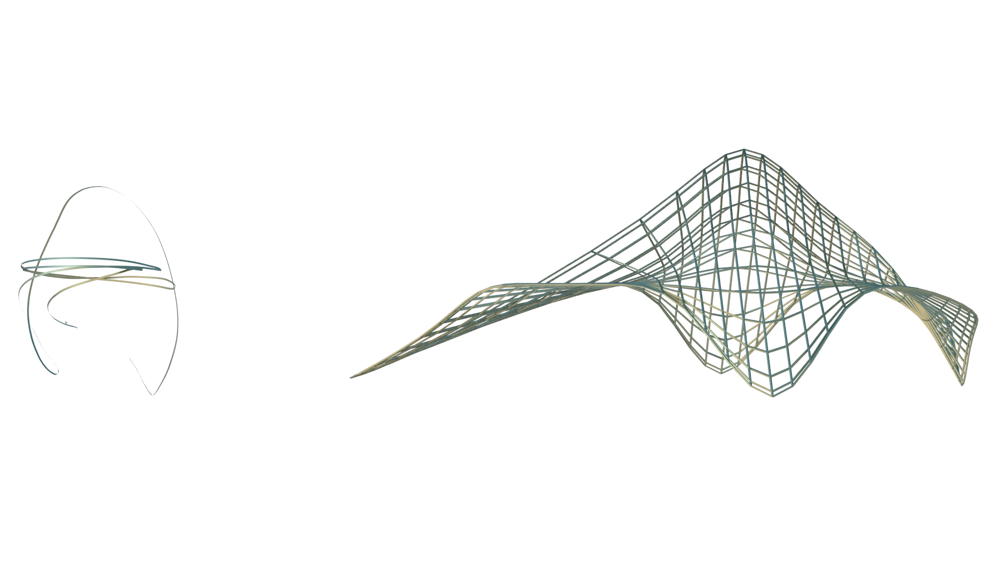
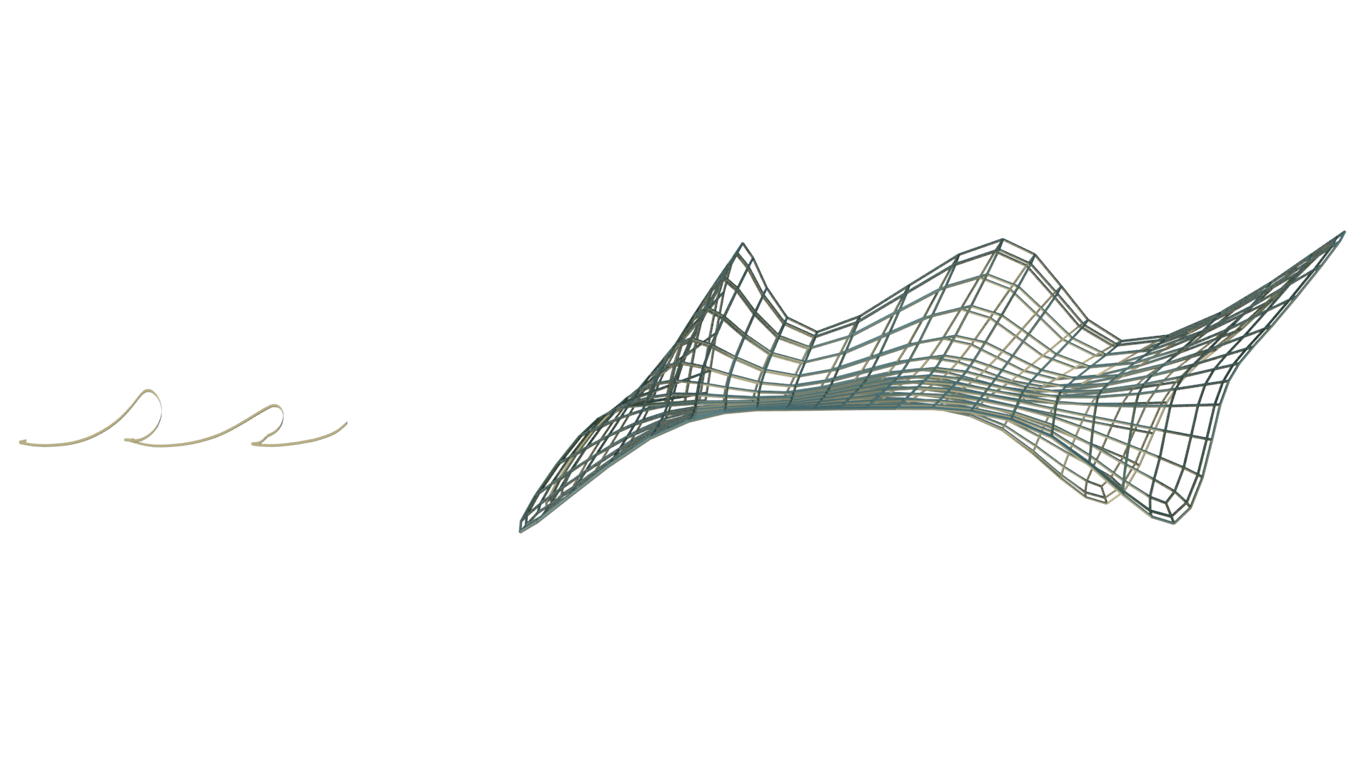
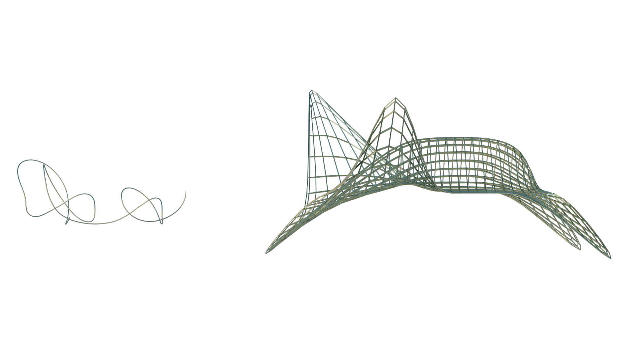
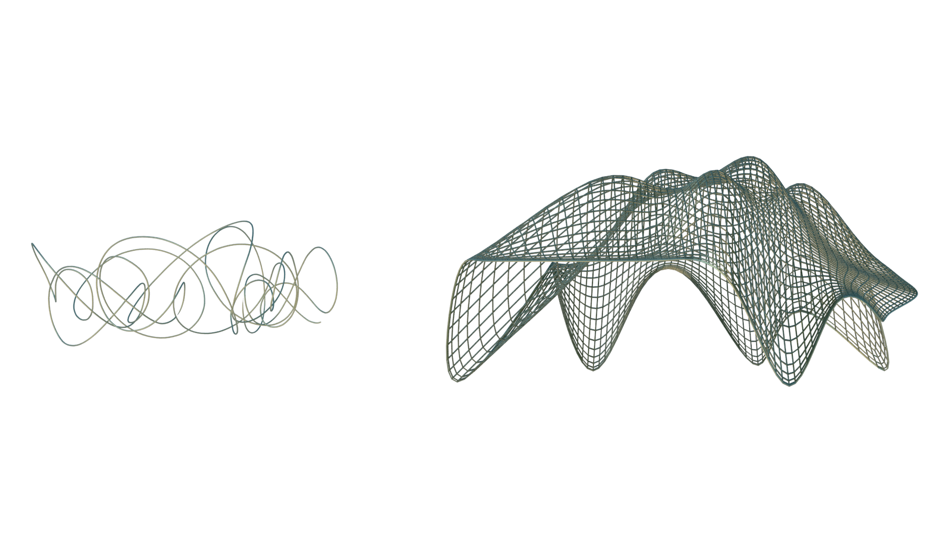
CLIMBING
RIDING ROLLER COASTER
FISHING
SWORD FIGHTING

Slide 20
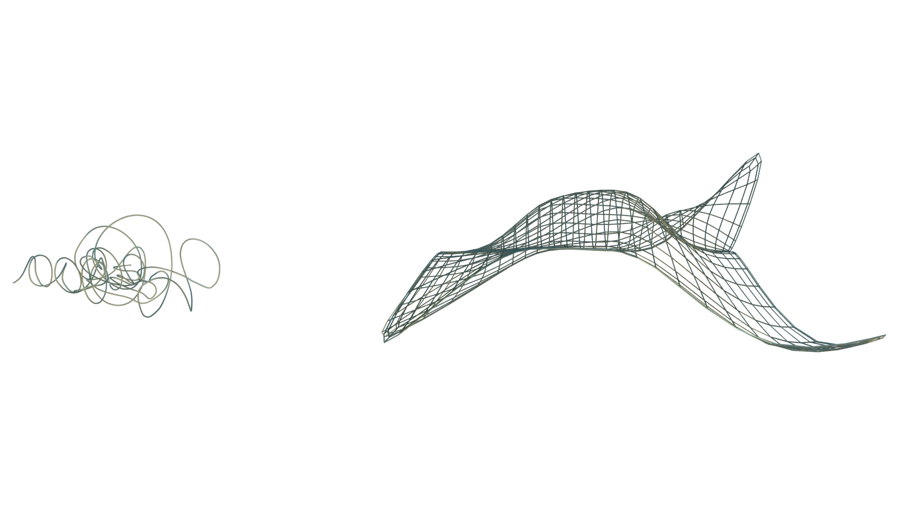
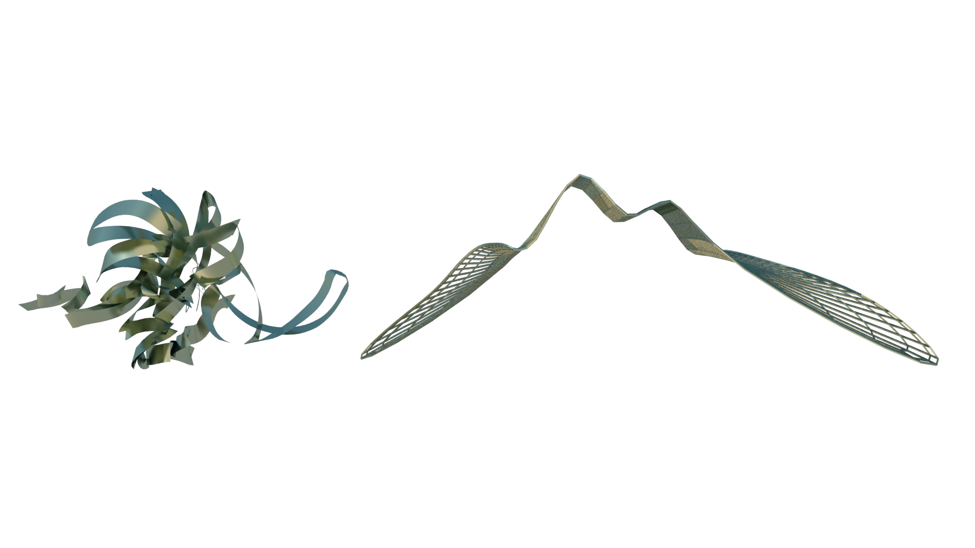
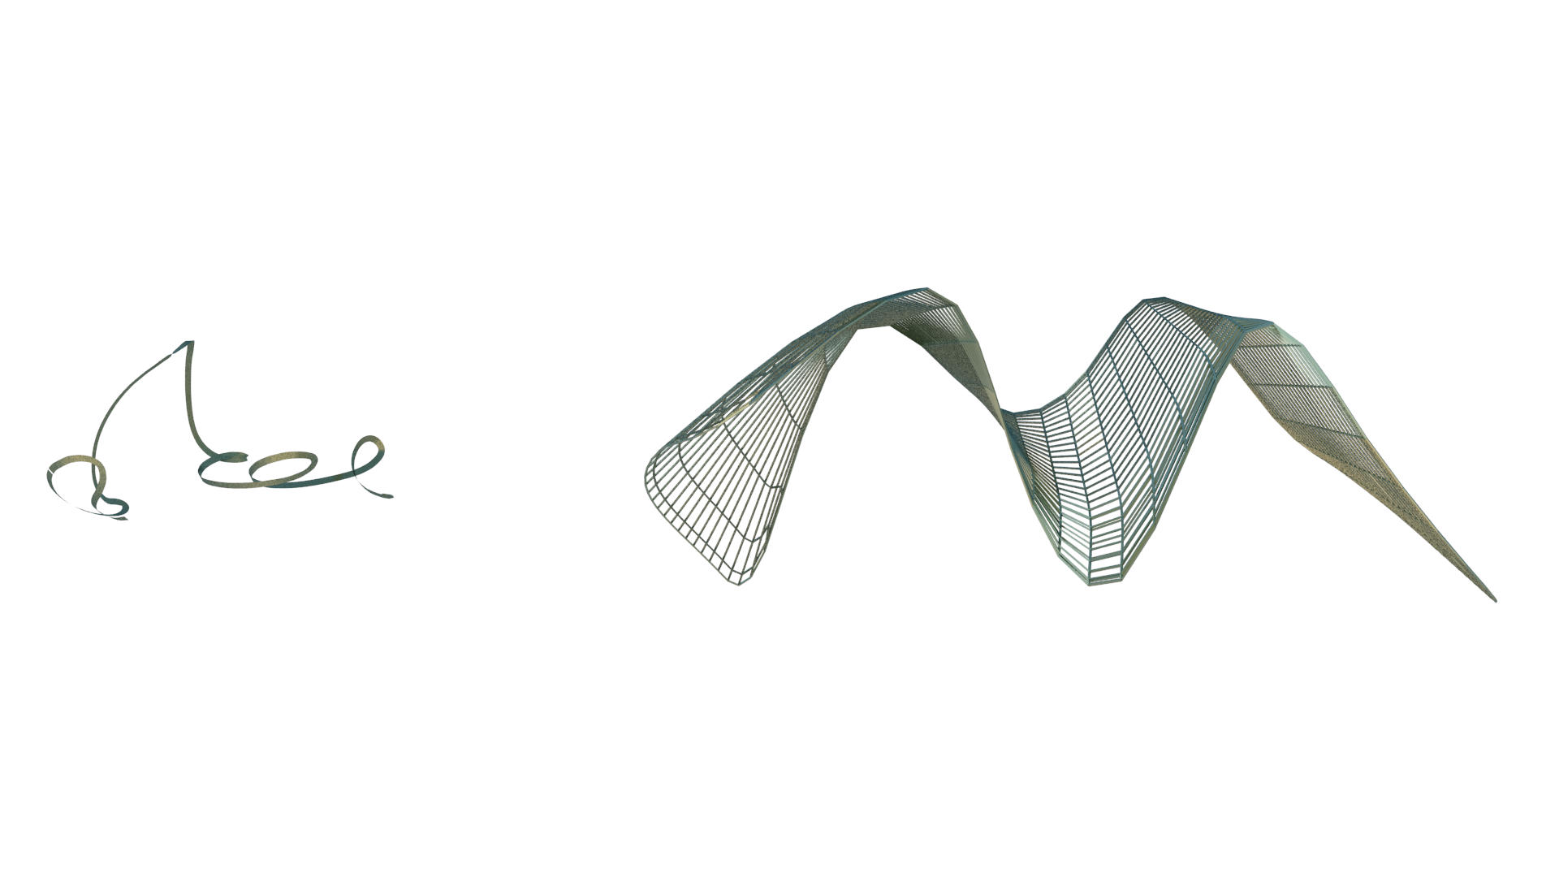
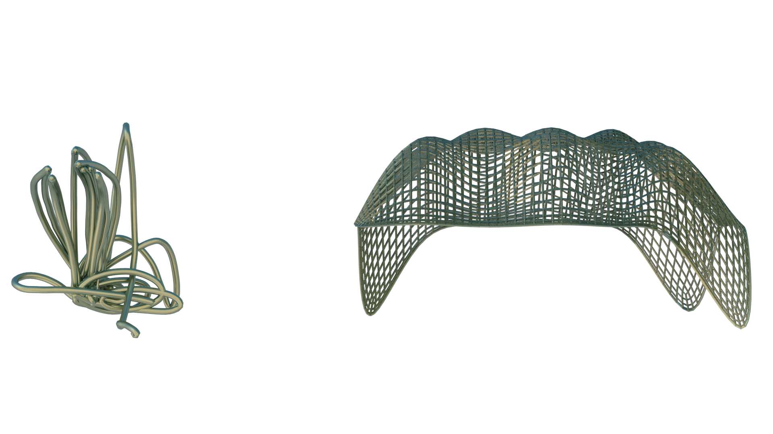
DRIVING
BOXING
SHOOTING
EATING/ FOOD SERVICING

Slide 21
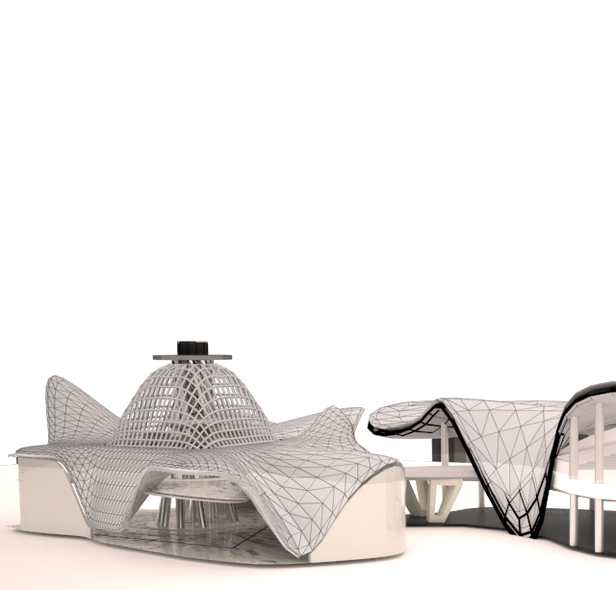
MOVEMENT SKETCHES > DECISION MAKING > EXPLORING THE POTENTIAL FORM WITH SITE CONTEXT
TESTING FORM WITHIN SITE CONTEXT
CLIMBING

Slide 22
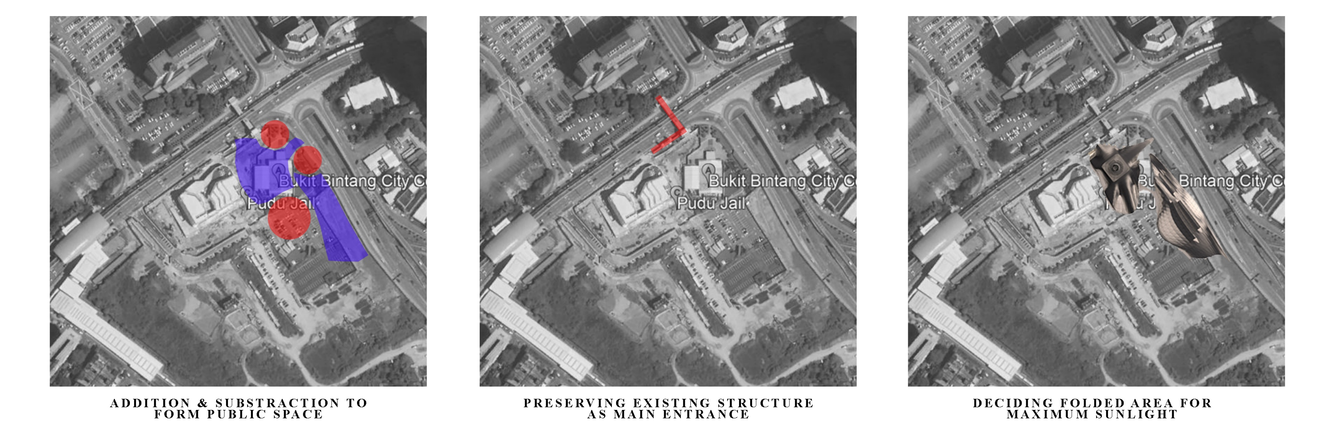
DESIGN THINKING

Slide 23
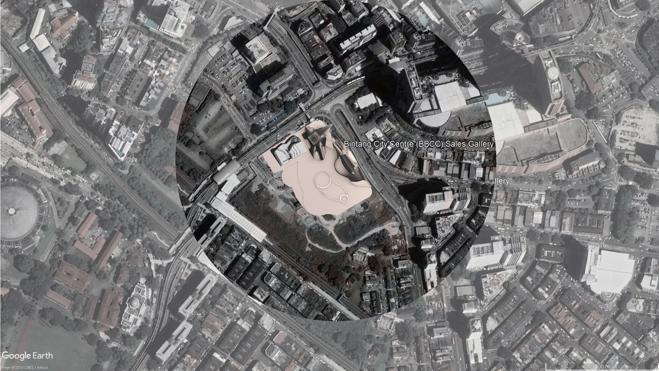

BUILDING ON SITE

Slide 24
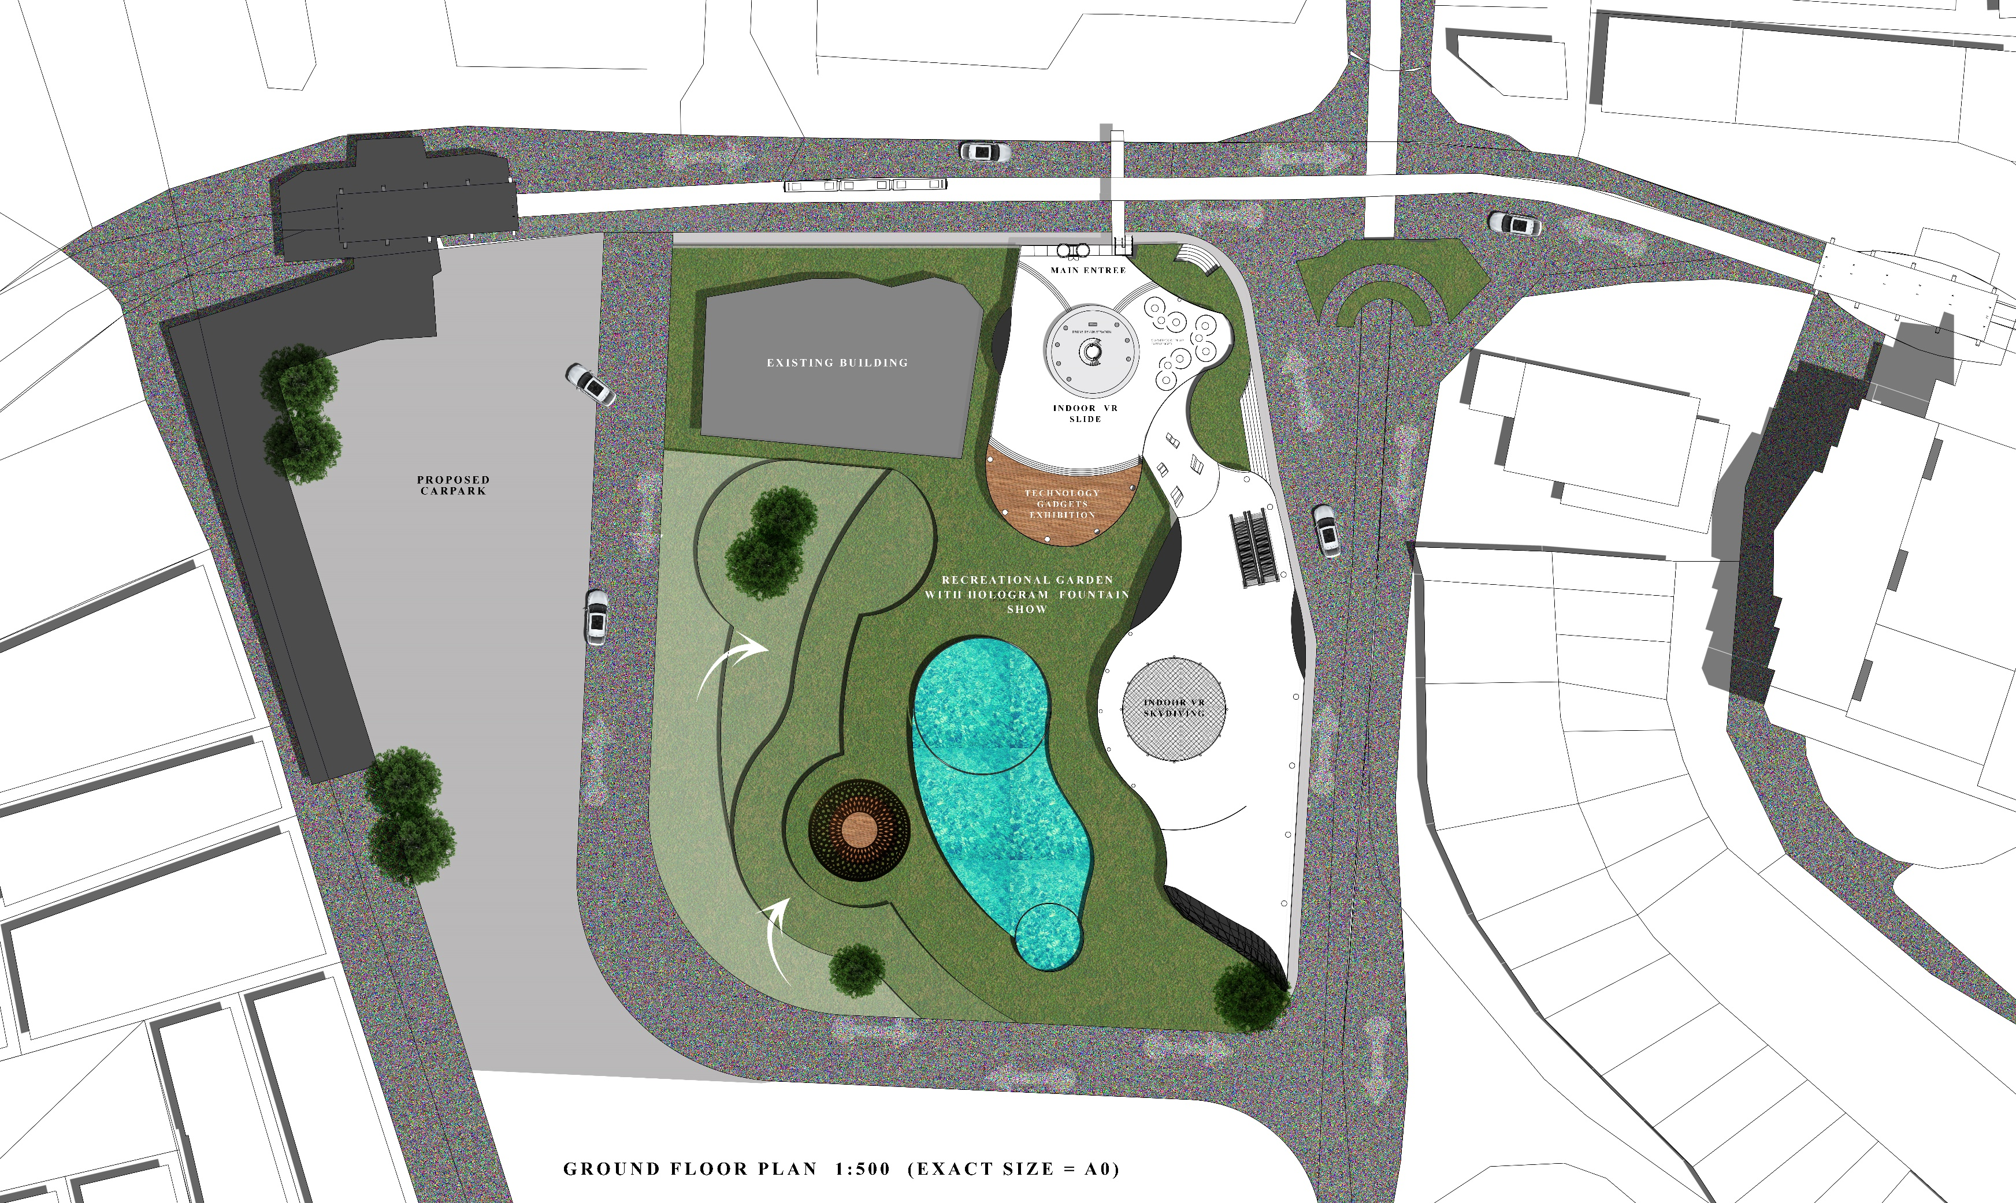
FLOOR PLAN

Slide 25
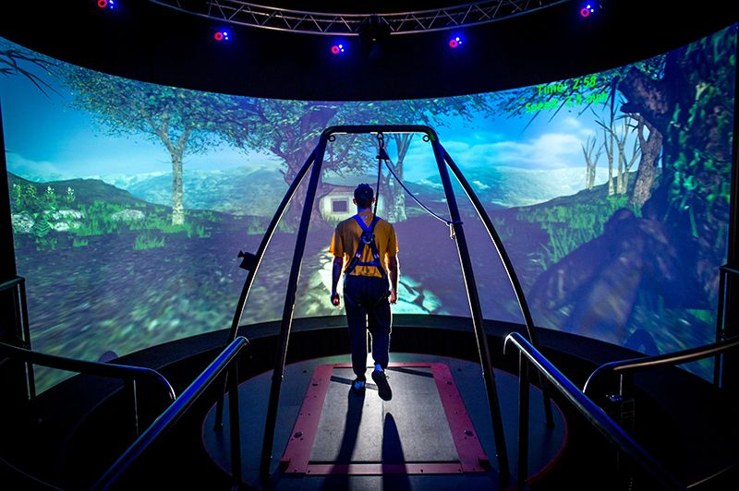



PROPOSE PROGRAM
3D CURVED SCREEN EXPERIENCES
VR SLIDE
INDOOR VR SKYDIVING
HOLOGRAM LIGHT SHOW

Slide 26

EXPLODED
AXONOMETRIC

Slide 27

BUILDING
SECTION

Slide 28

INTERIOR – GET READY VR HEADSET
Watch : https://youtu.be/8a-3UDksfVY

Slide 29

360 VR EXPERIENCE – GET READY YOUR HEADSET
Watch : https://youtu.be/8a-3UDksfVY

Slide 30

360 VR EXPERIENCE – GET READY YOUR HEADSET
Watch : https://youtu.be/8a-3UDksfVY

